Slide 1

VA250.org
Notes:
Virginia is where it all started. Without Virginia, there are no founding documents, no Constitution, no first Presidents.
From Revolutionary War, to Civil War, to Civil Rights. The very fabric of our national identity was created in Virginia and those stories abound.

Slide 2

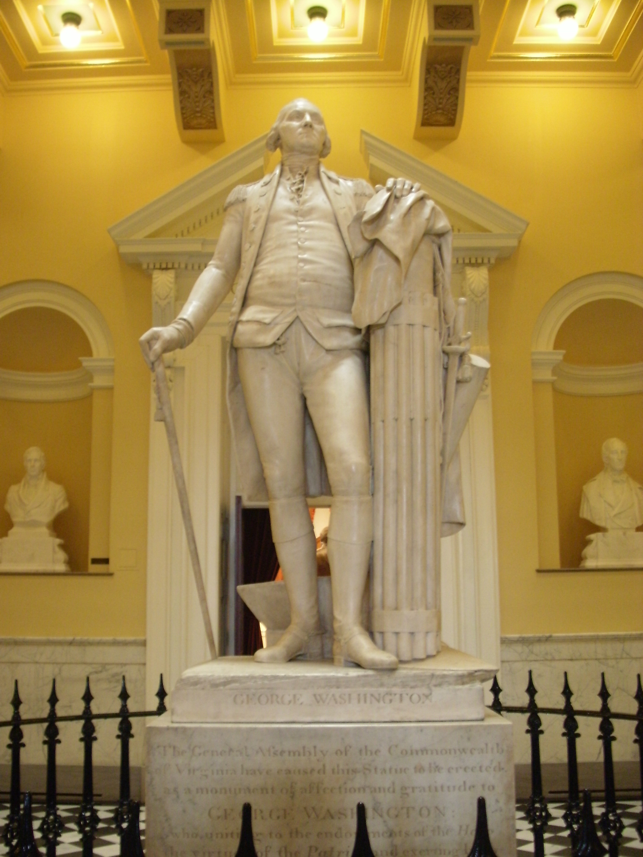
Virginia’s History is America’s Story
VA250
Mother of Presidents
George Washington - Mount Vernon, Arlington - Popes Creek, Westmoreland
Thomas Jefferson - Monticello, Albemarle - Poplar Forest, Lynchburg
James Madison - Montpelier, Albemarle
James Monroe - Highland, Albemarle
William Henry Harrison - Berkely Plantation, Charles City
John Tyler - Sherwood Forest, Charles City
Zachary Taylor - Montebello, Orange County
Woodrow Wilson - The Manse, Staunton
Patrick Henty – Red Hill, Charlotte County
Notes:
Jamestown (first colonists, first encounters with Indigenous peoples, first enslaved Africans). Williamsburg (Committee of Correspondence, Colonial capital). Yorktown (decisivie victory of American Revolutionary War). Fincastle (1772, named after Lord Fincastle, son of Lord Dunmore) with courthouse designed by Thomas Jefferson. Also where Lewis and Clark departed from Fincastle when commissioned by President Thomas Jefferson to explore the Louisiana Purchase.
The very fabric of our national identity was created in Virginia and those stories abound. What is your local story?

Slide 3
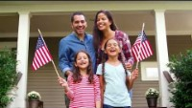

Slide 4
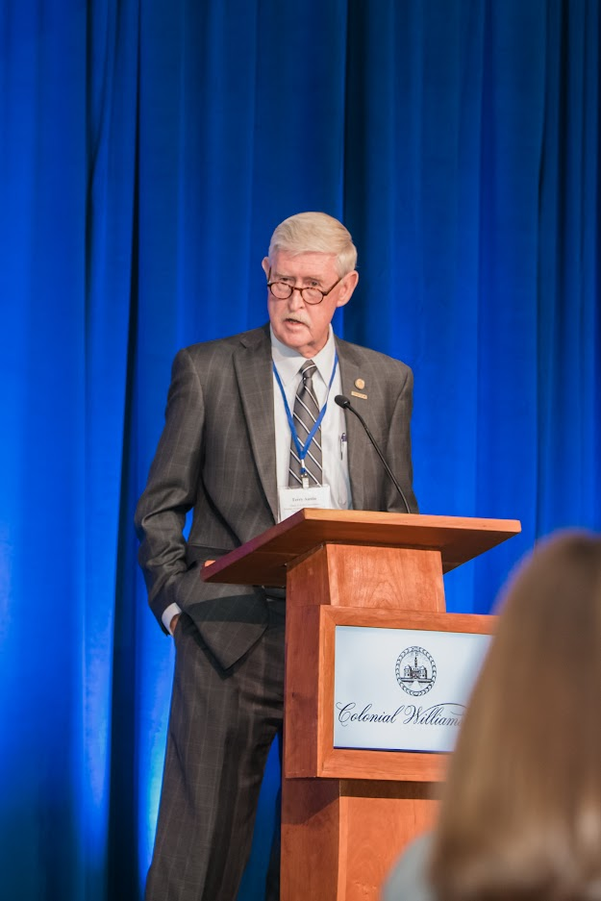
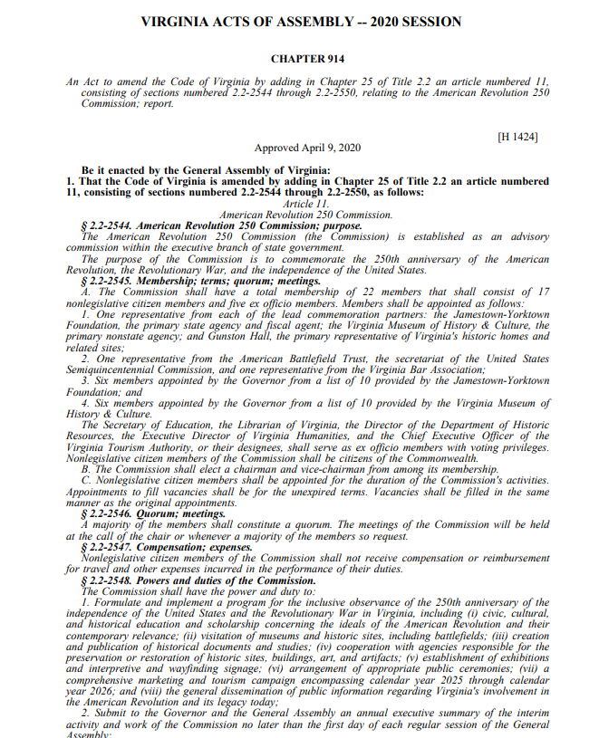
Commission Membership
Department of Historic Resources
Library of Virginia
Virginia Bar Association
American Battlefield Trust
  General Assembly leadership
    Del. Terry Austin, Chair
    Sen. Mamie Locke, Vice Chair
  Colonial Williamsburg
  VMHC
  JYF
  Gunston Hall
  Monticello
  Secretary of Education
  Virginia Tourism

Slide 5
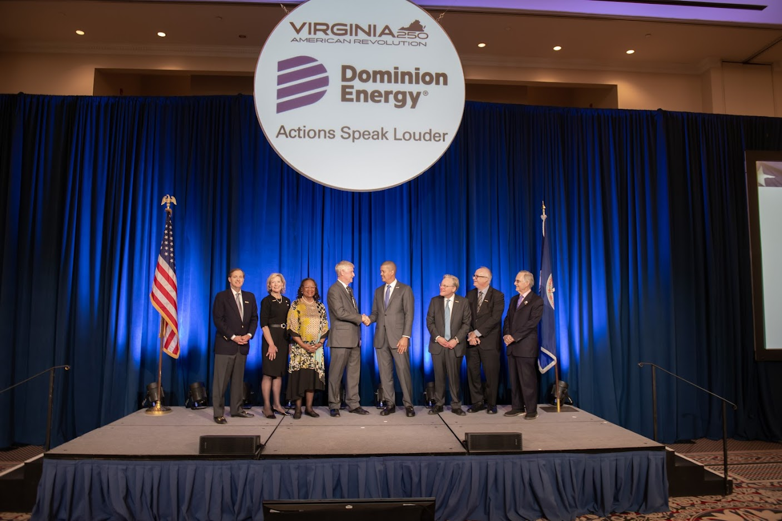
Virginia leads the nation’s 250th
About VA250
Statewide commemoration
Multi-faceted
Inclusive of all perspectives
Every Virginian can see their story
Strong state support
Robust local committees
Committed corporate partners
50-state partner collaborations

Slide 6
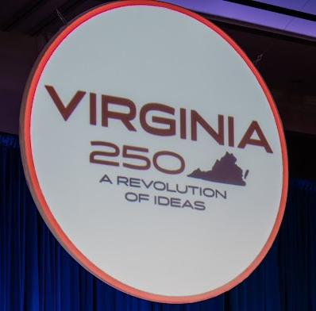
Guiding Principles and Themes
Themes
Virginia’s history is America’s story.
What’s your local story?
Celebrate Virginia!
In Virginia, the American Revolution was a war, and more than a war. It was a Revolution of Ideas.

Slide 7
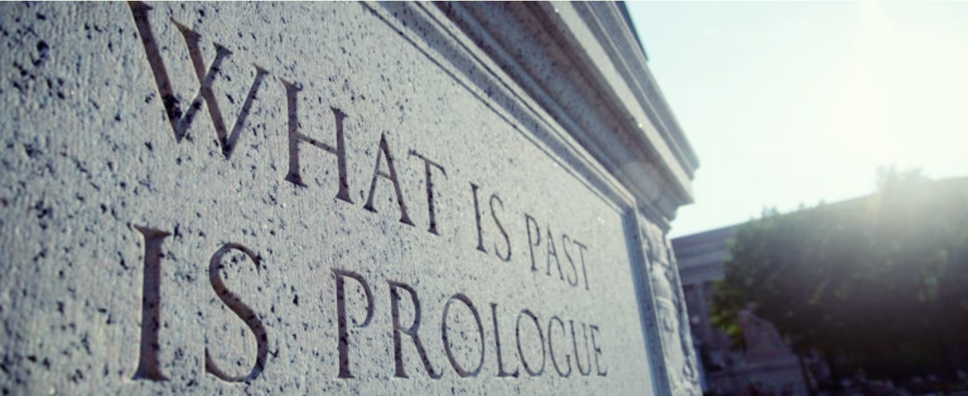
Economic Impact of Commemorations
$1.5 Billion economic impact to Virginia
22,000 Jobs created across the Commonwealth
$50 Million in state and local tax revenue
9 Million people participating in events and programs
Extensive media impressions, interviews, articles, social media interaction

Slide 8

Plans in Development

Slide 9
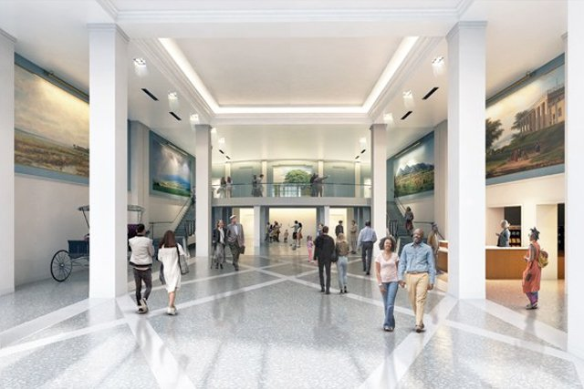
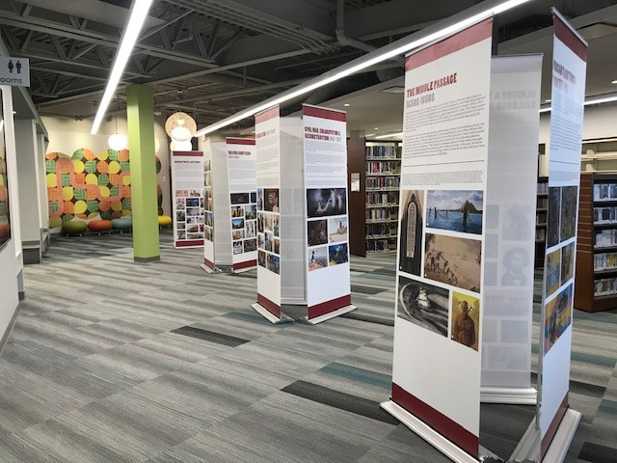
Signature Exhibition with Traveling Panels
Plans in Development
Partnership between Virginia Museum of History and Culture and Jamestown Yorktown Foundation
(Part I) 5,000 sq. ft. cutting-edge museum exhibition with online component for schools
(Part II) Traveling Panel Exhibition
  Provided to localities, at no cost, for display in small museums, libraries, community centers
Notes:
Shared installation
VMHC: March 2025 – January 2026
American Revolution Museum at Yorktown: April 2026 – January 2027
Exhibition may then travel to other museums across Virginia

Slide 10
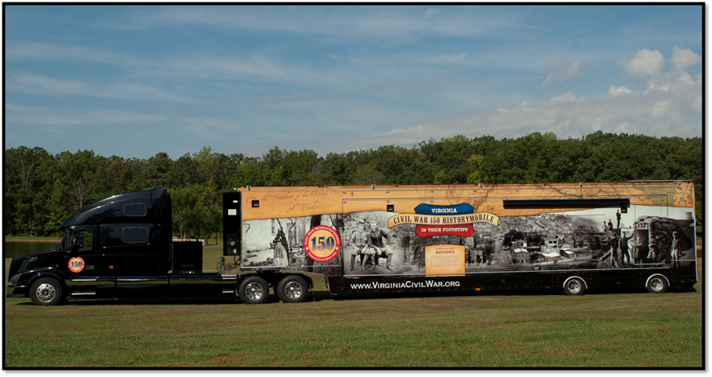
Mobile Museum
Mobile Museum
Plans in Development
Notes:
Immersive, interactive exhibit
Will travel to every locality . . . . And beyond!
National centerpiece
Events in Boston, Philadelphia – we can be right there!

Slide 11
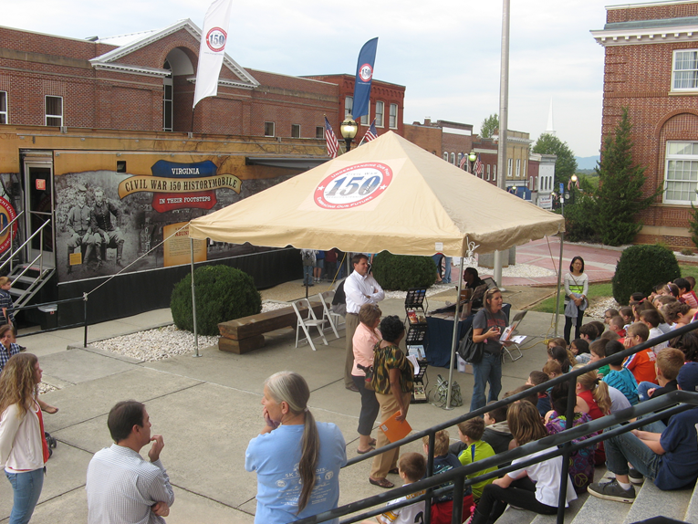
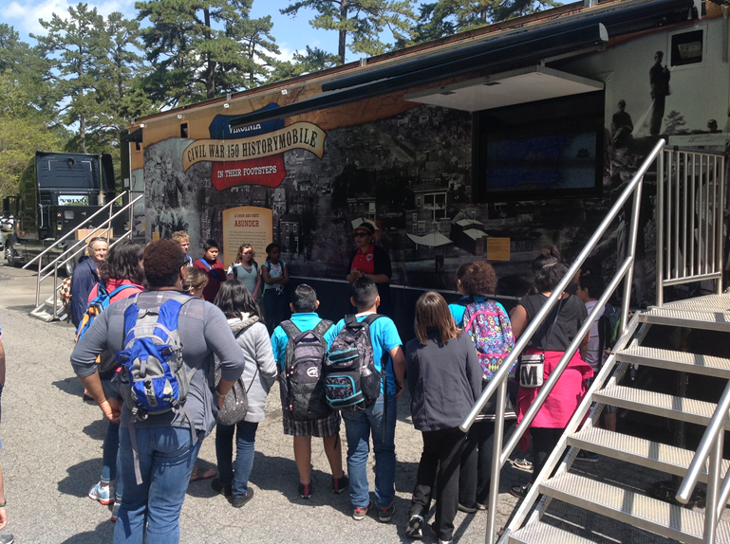
Mobile Museum: Schools
Notes:
Museum travels directly to schools
Hard for many localities to afford field trips – Classroom for the day
Teacher Resources and pre-visit/post-visit classroom materials

Slide 12
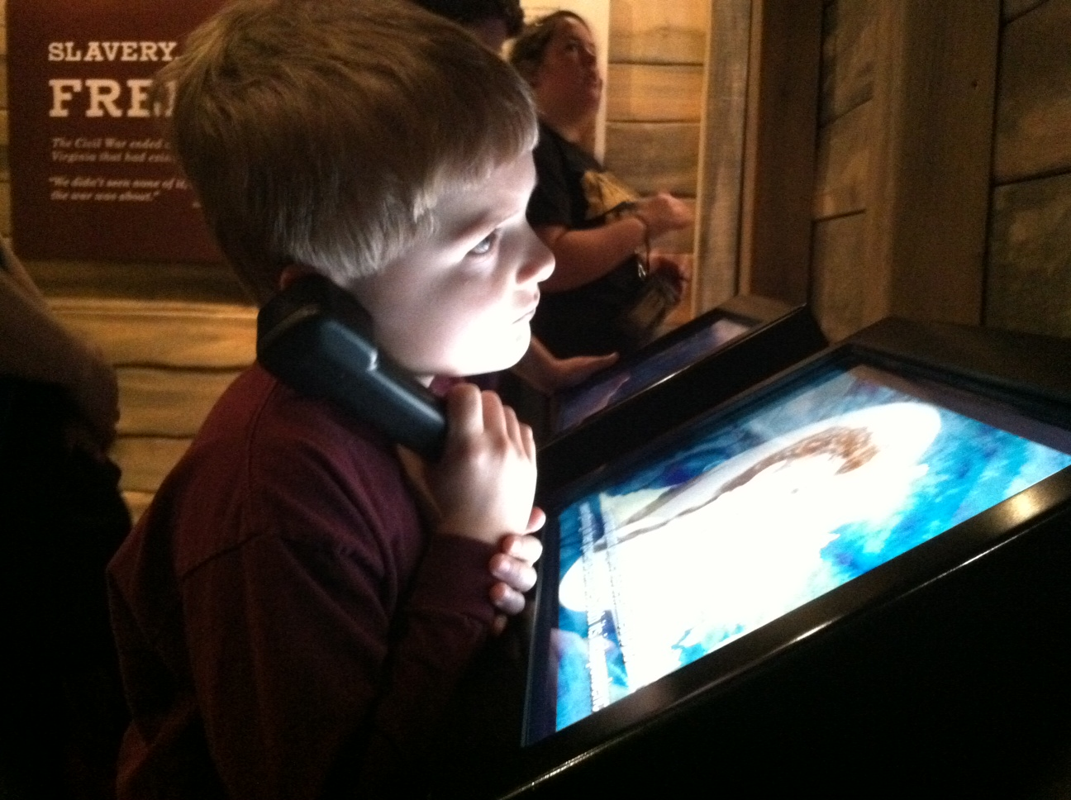
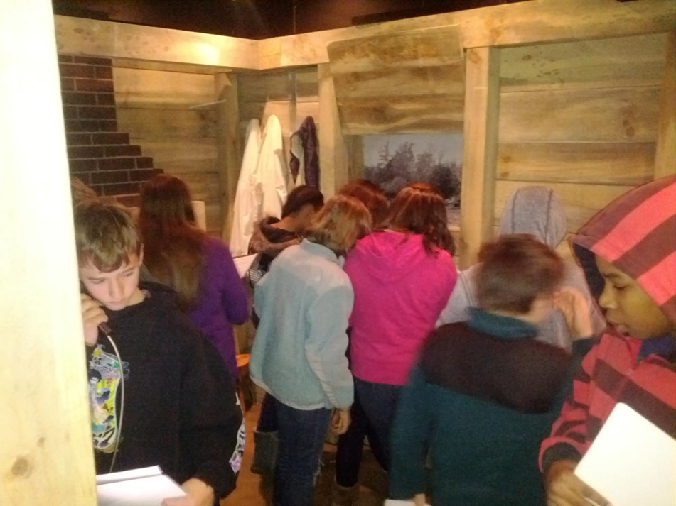
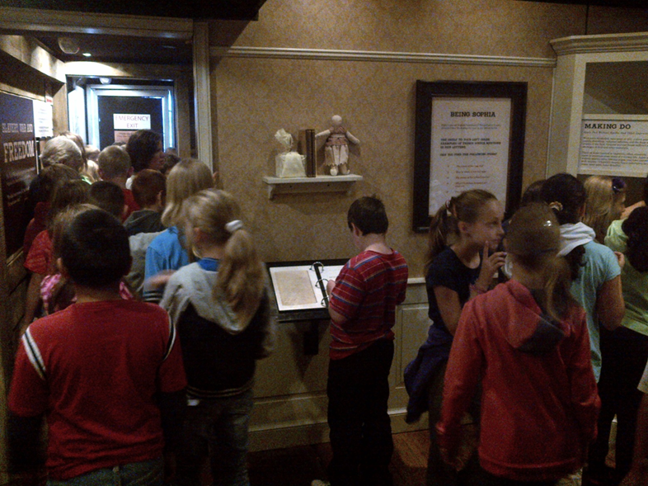
Mobile Museum: Schools
Notes:
Hands-on learning
Interactive
Captures students’ imagination

Slide 13
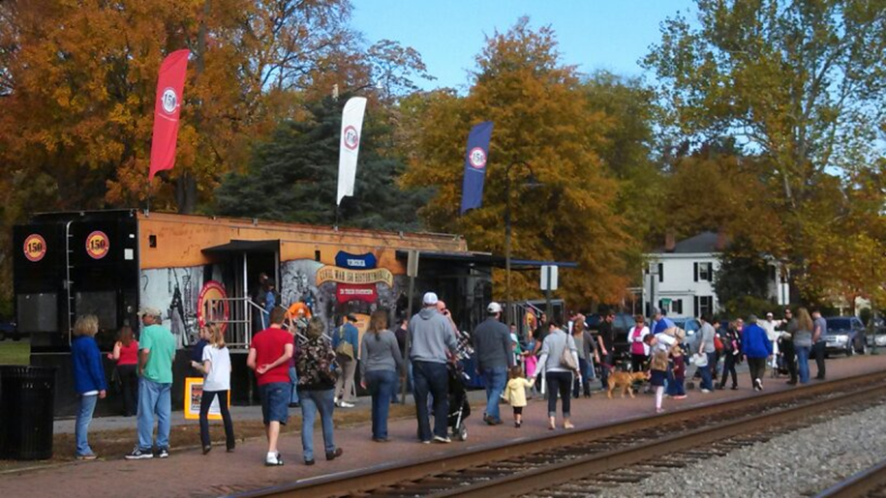
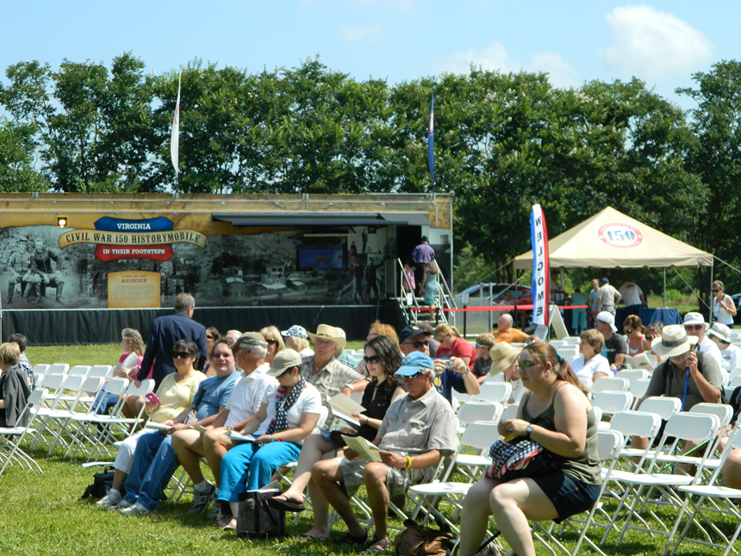
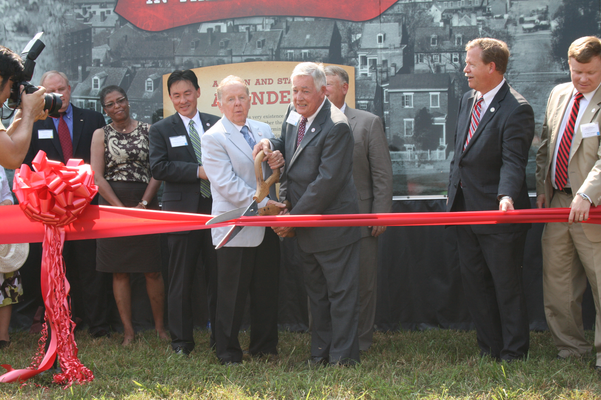
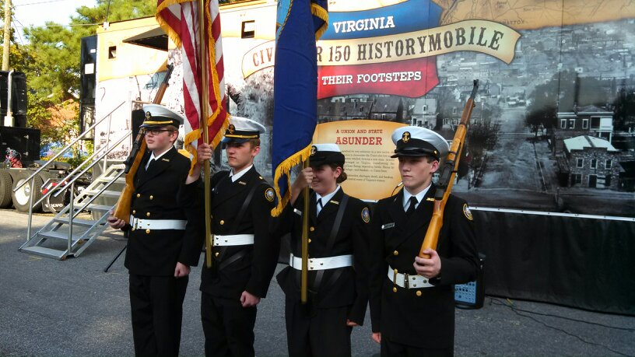
Mobile Museum: Centerpiece of Events
Notes:
Centerpiece of planned events (Ashland Train Day, State/county fairs)
And sometimes. . .
It *is* the event – localities plan a weekend of events around the Mobile Musuem visit – add lectures, bands, document scanning, veteran recognition

Slide 14
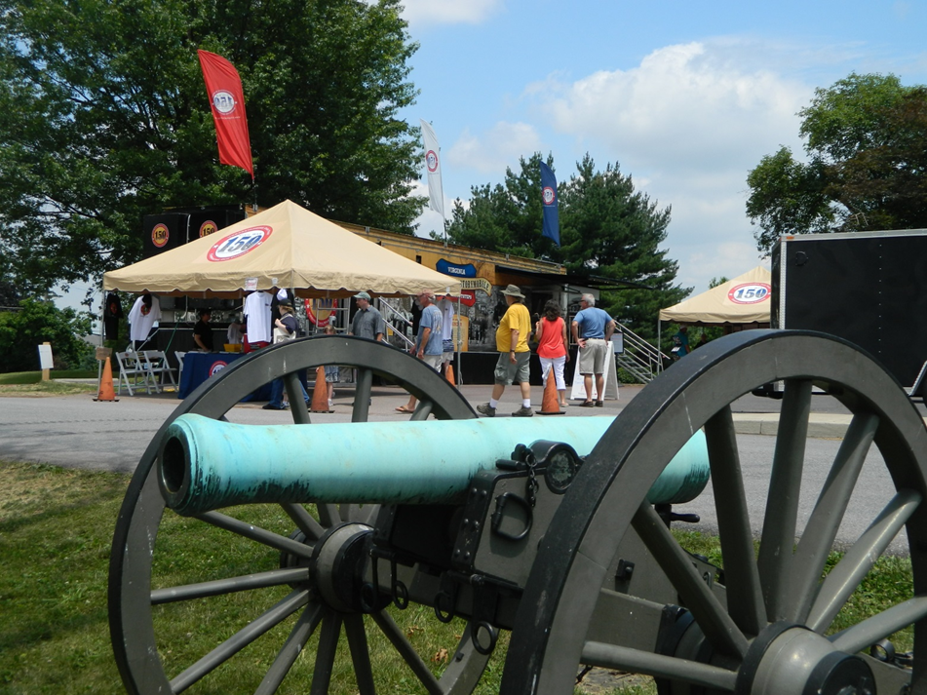
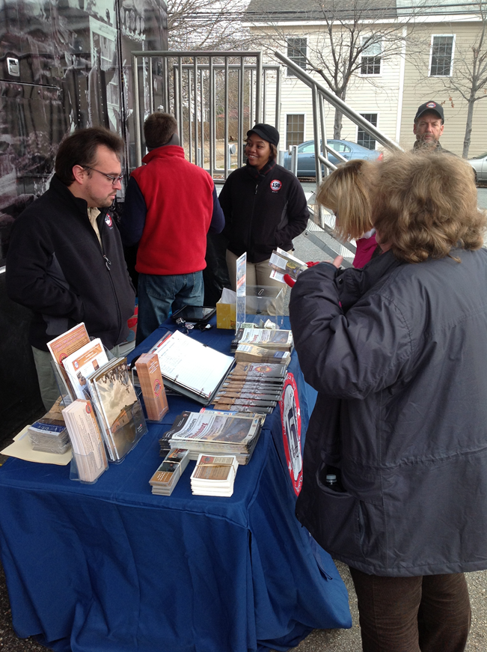
Marketing and Partner Messaging
Notes:
Virginia Welcome Center on Wheels
Operate in partnership with VTC
Marketing tents and displays are set up at every event
Partner / donor messaging has wide reach

Slide 15
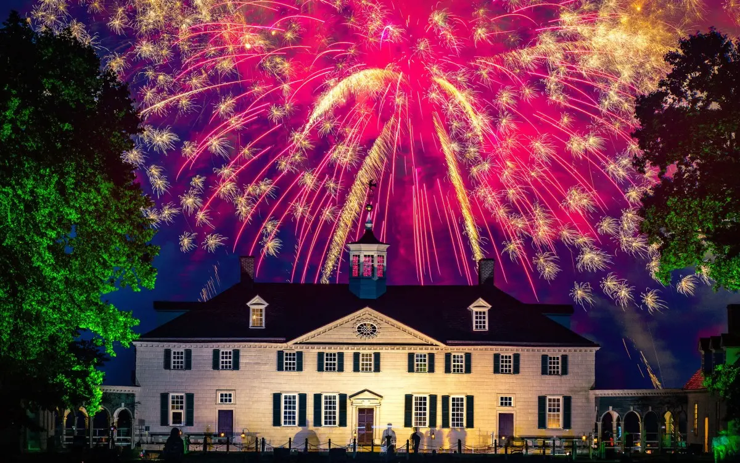
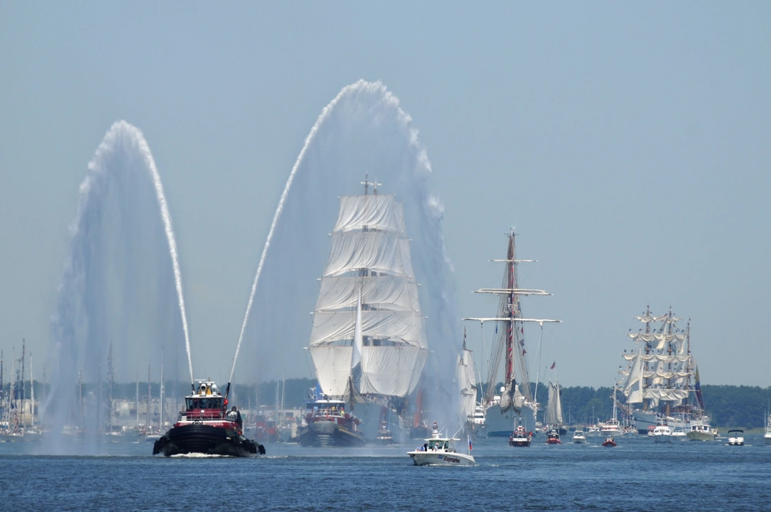

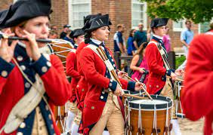
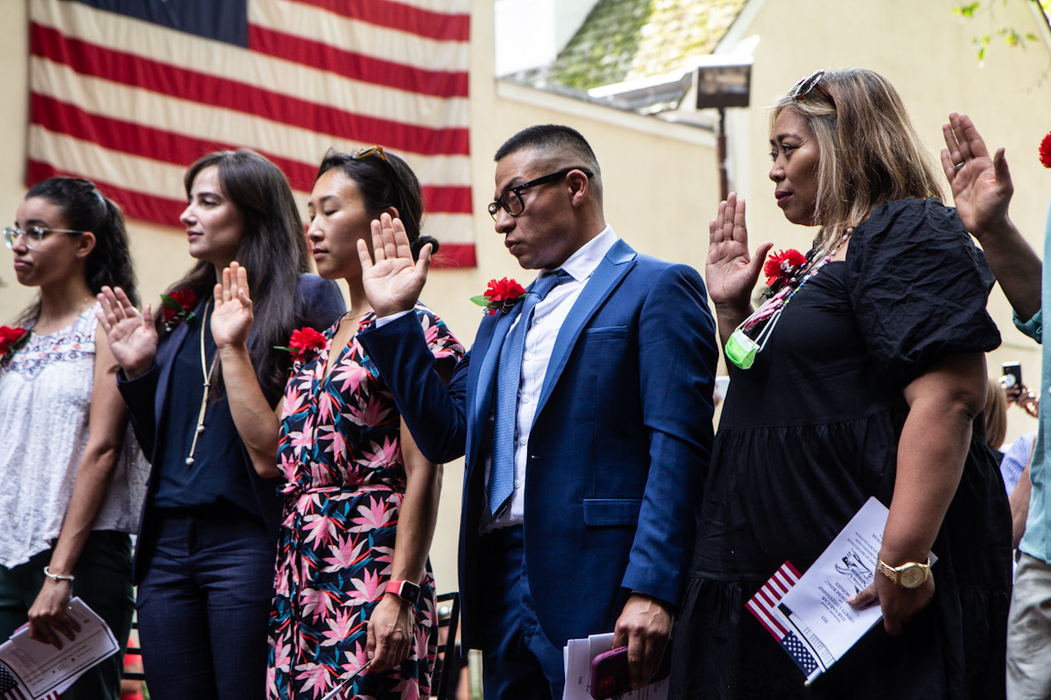
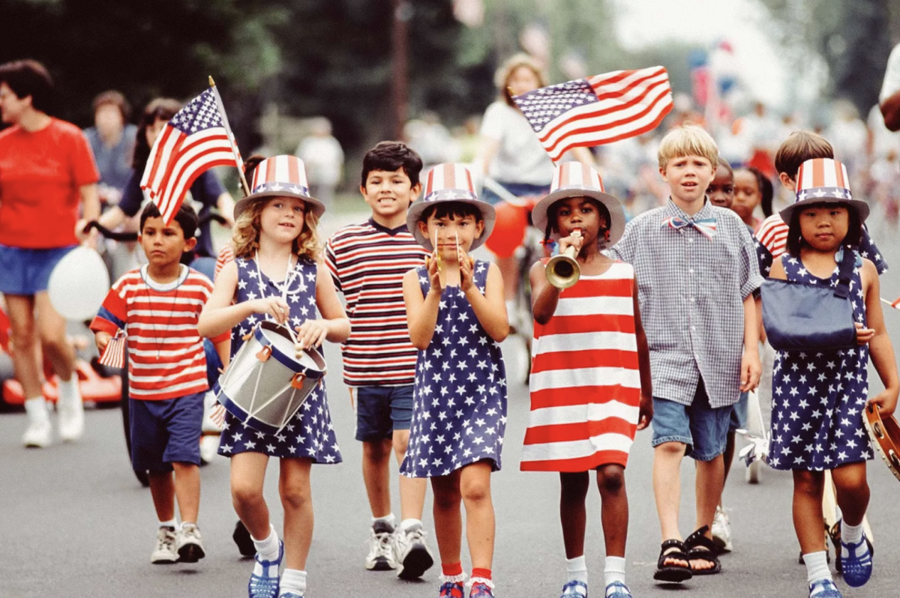
2026
Signature Events and Conferences
1776
Notes:
Everyone thinks of the 250th as happening in 2026, marking the signing of the Declaration of Independence in 1776
And that’s true. . . .
Special events and conferences will be happen throughout the nation in 2026 and Virginia will lead the way:
Sail 250: National six-port tall ship sail docking in Norfolk and Alexandria
250th Fifth Virginia Convention: Virginia’s Independence Day (May 15)
250th Declaration of Independence (July 4)
Large-scale Naturalization Ceremony
Statewide tolling of bells
Events to honor military and veterans
Massive fireworks show at key locations
But it’s not the whole story. . . .

Slide 16
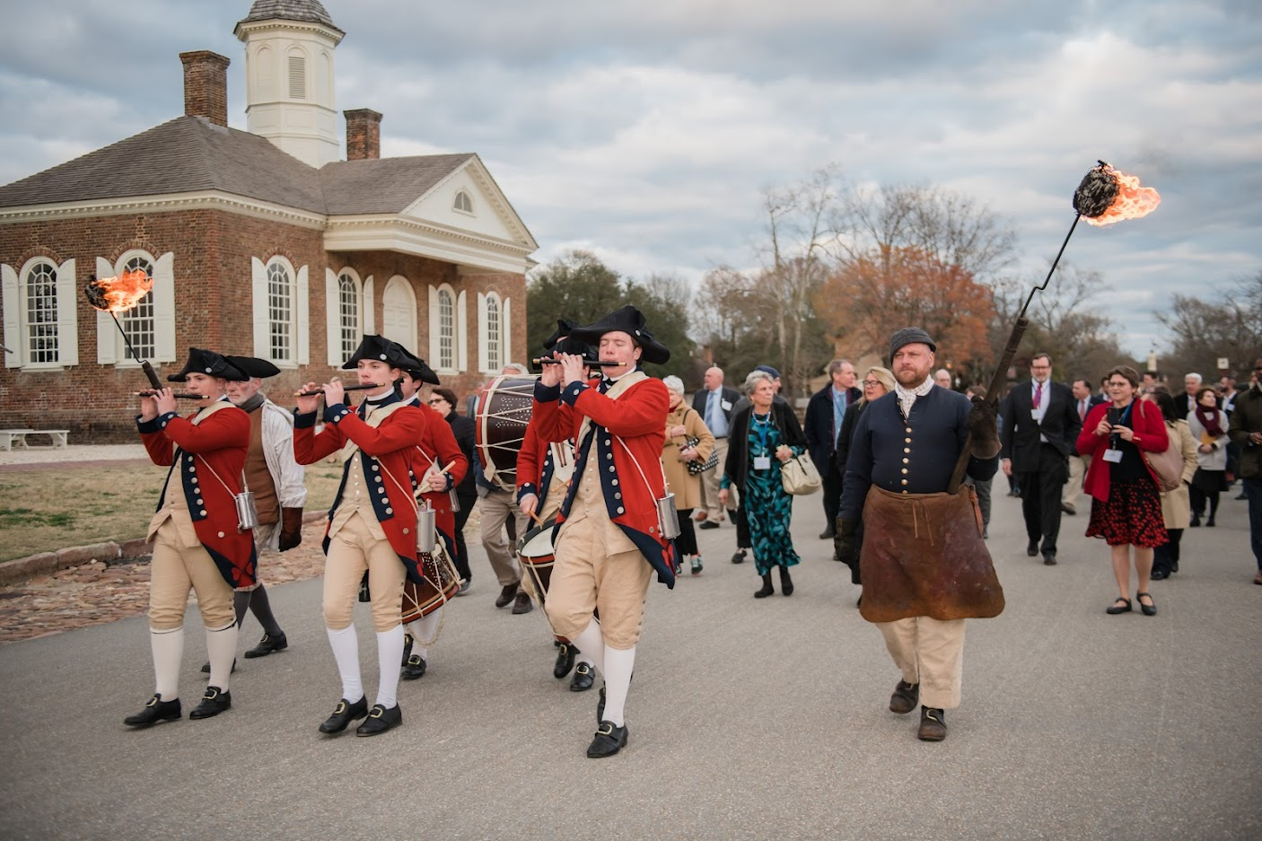
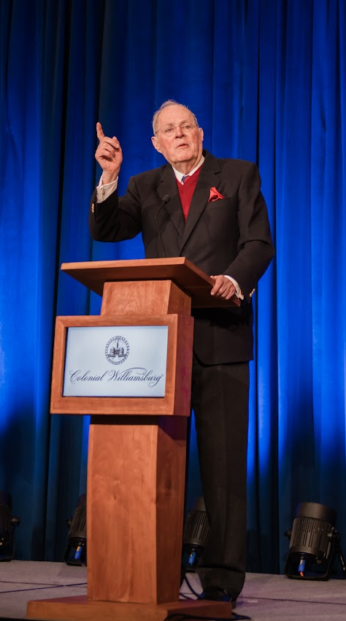
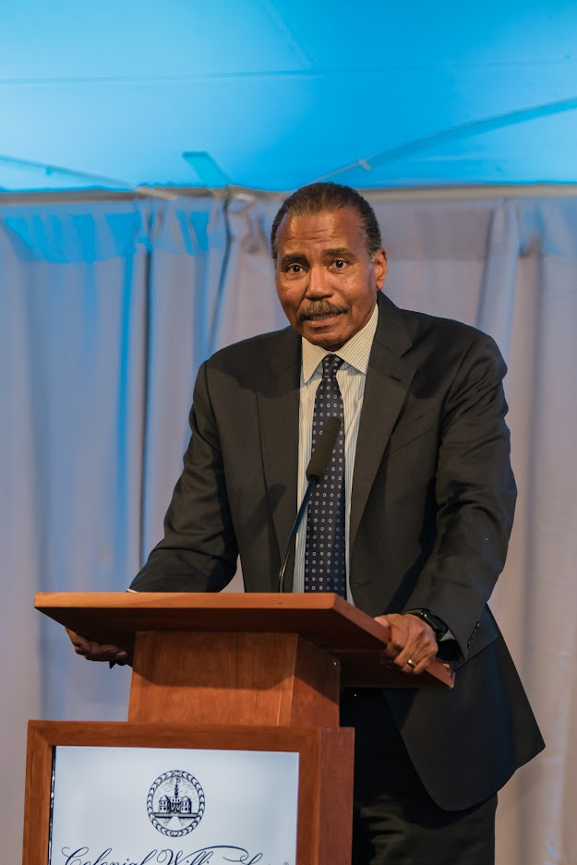
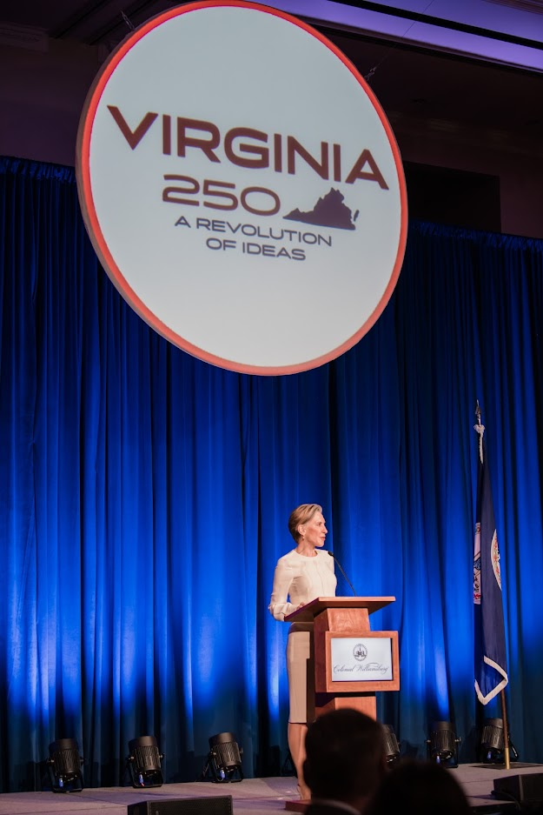
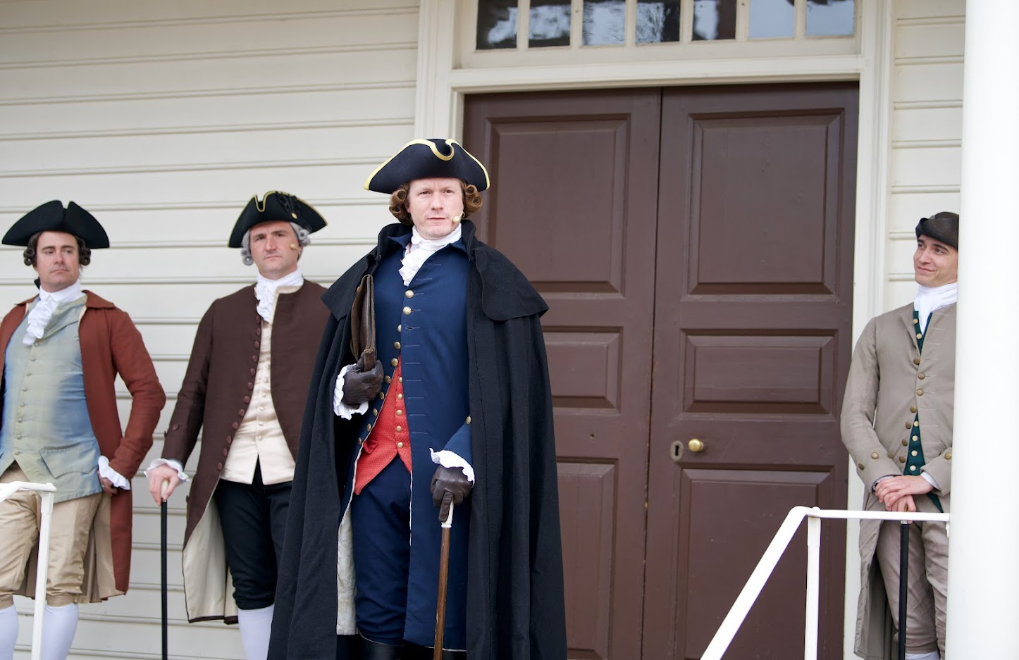
A Common Cause To All
Notes:
HOWEVER, in Virginia, the 250th begins NOW and go through 2031, marking events of
1773 – 1781 including:
2023: A Common Cause to All – 250th Anniversary of Committees of Correspondence
2024: Lafayette’s Grand Tour 200th – 26-state Guest of the Nation Tour
250th Yorktown Tea Party (Nov. 9, 2024)
2025: Law Symposium “The Legal Revolution: Virginia Leads the Way to Liberty”
250th Patrick Henry’s “Give Me Liberty or Give Me Death”
2026: Virginia takes key role on national stage
2031: Siege of Yorktown and British Surrender at Yorktown

Slide 17

A Common Cause To All
Save the Date!
2024
Monday, March 18 – Wednesday, March 20
2025
Monday, March 24 – Wednesday, March 26
Colonial Williamsburg
Williamsburg Lodge
Notes:
HOWEVER, in Virginia, the 250th begins NOW and go through 2031, marking events of
1773 – 1781 including:
2023: A Common Cause to All – 250th Anniversary of Committees of Correspondence
2024: Lafayette’s Grand Tour 200th – 26-state Guest of the Nation Tour
250th Yorktown Tea Party (Nov. 9, 2024)
2025: Law Symposium “The Legal Revolution: Virginia Leads the Way to Liberty”
250th Patrick Henry’s “Give Me Liberty or Give Me Death”
2026: Virginia takes key role on national stage
2031: Siege of Yorktown and British Surrender at Yorktown

Slide 18
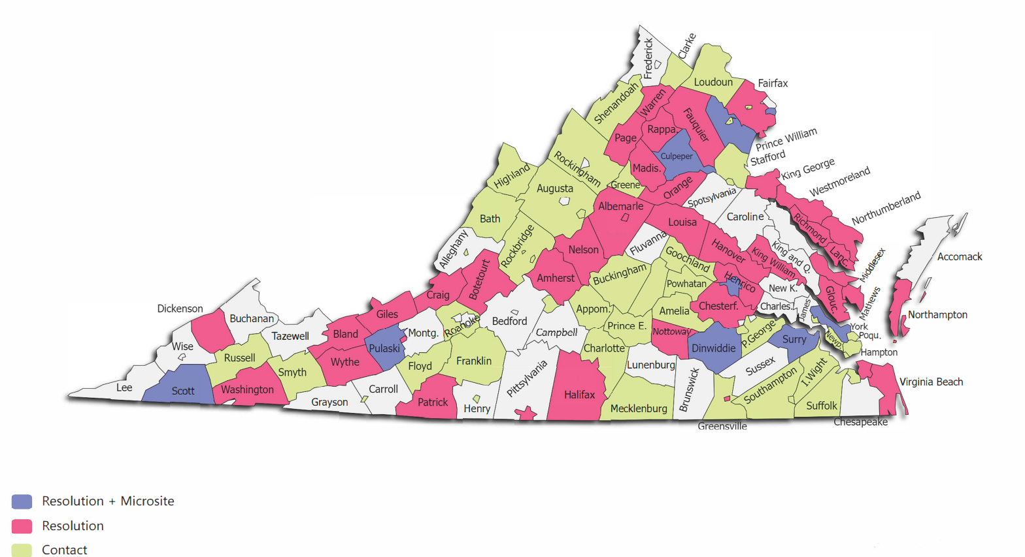
Local VA250 Committees

Slide 19
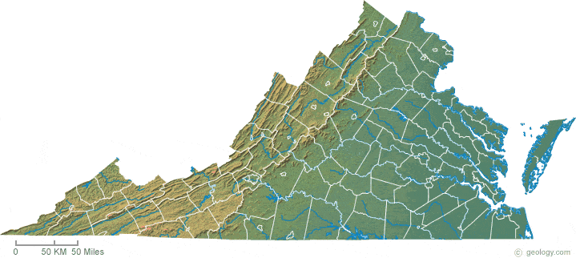
Resources to support Local VA250 Committees
Local VA250 Committees
Interactive Statewide Calendar of Events
Dedicated page on VA250.org to highlight local history, events
Customized logo with locality name
Amplification of events across social media
VA250 grant program to provide funding to local committees
  Virginia Tourism VA250 Marketing Leverage Grants
    Specifically includes Road to Revolution interpretive signage
  Virginia Humanities VA250 Content Development Grants
  Virginia Commission for the Arts Community Partnership Program Grants

Slide 20
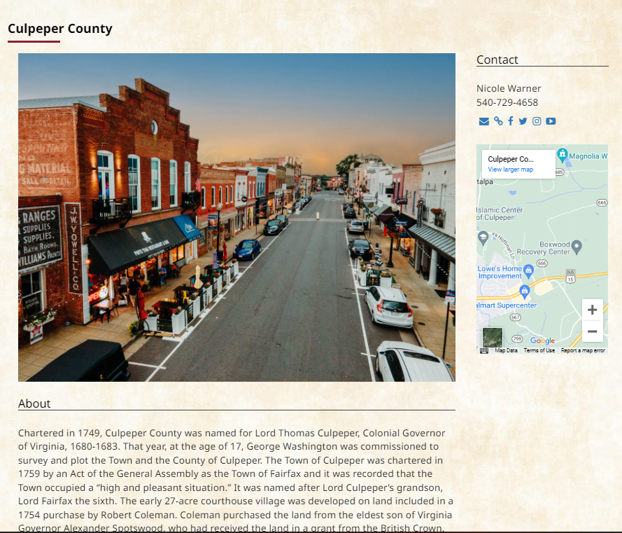
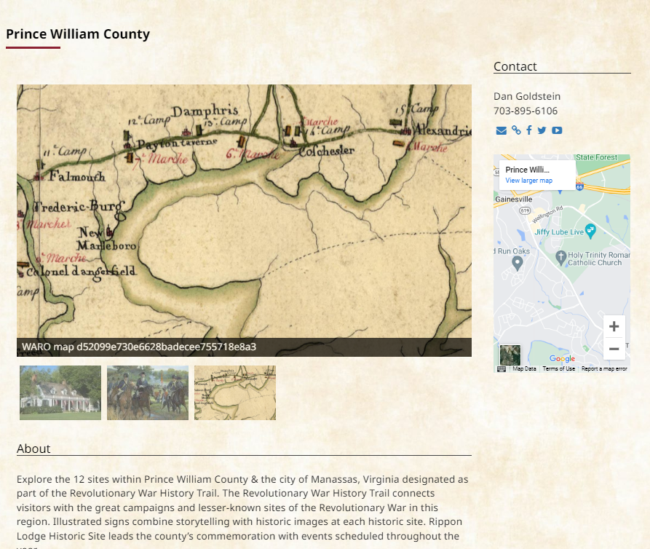
VA250 Website Page

Slide 21
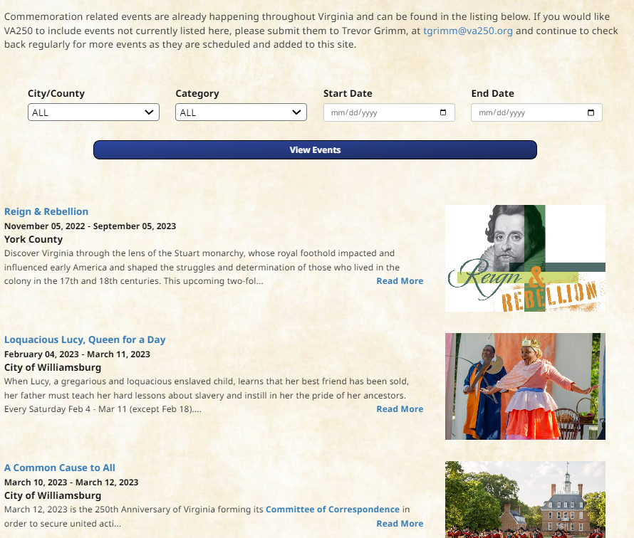
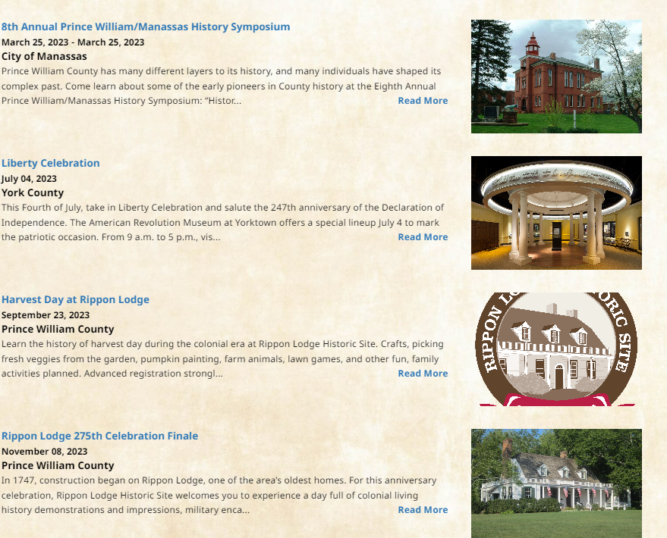
Statewide Calendar of Events

Slide 22
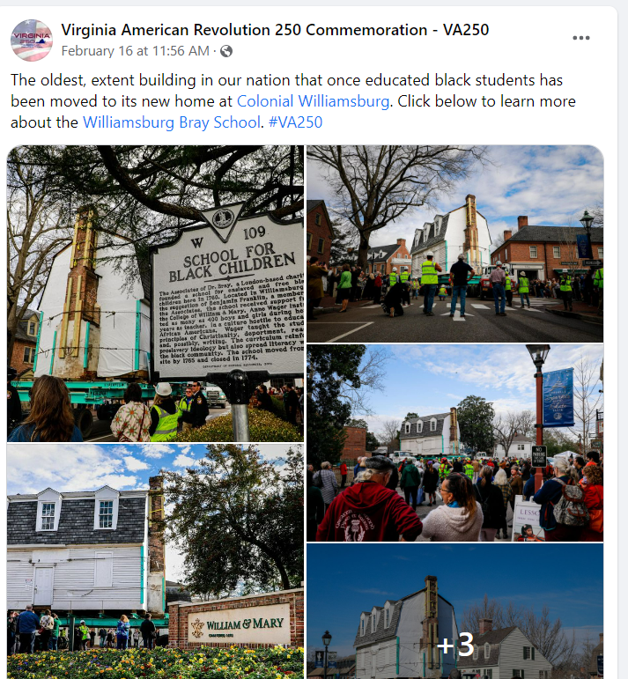
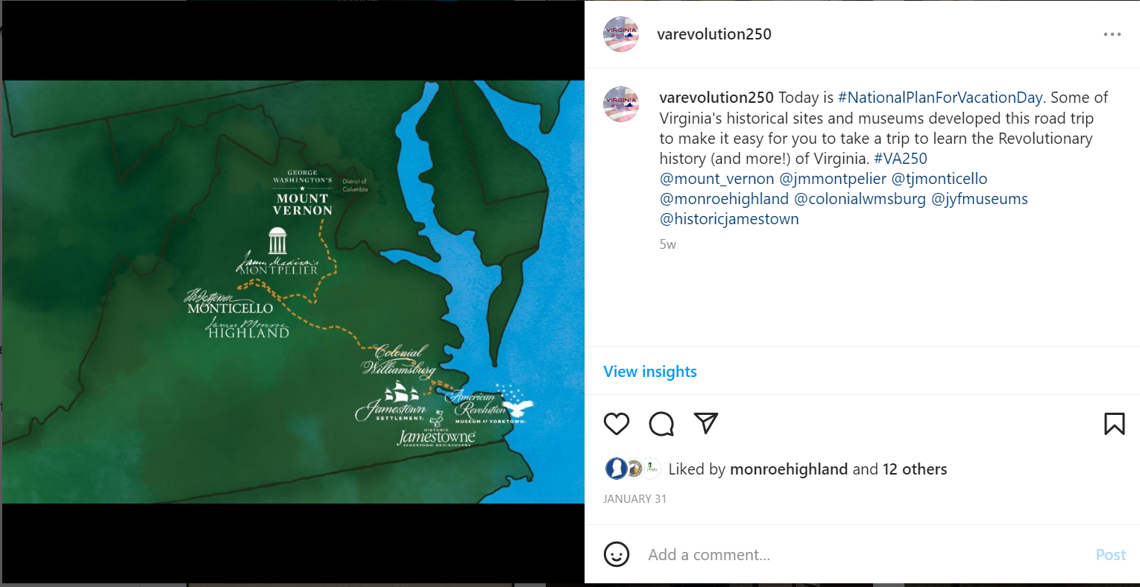
Sharing and Promoting Events & Places to Visit

Slide 23




Custom Locality Logo

Slide 24
Tips for Local Committees
Tips for Local VA250 Committees
Convene interested stakeholders – work regionally – include DMO
Resolution of support passed by local governing body (grant eligibility)
Make a plan of events you’d like to do, anniversaries to mark, and apply for VA250 grants to support them
What’s your local story? Identify stories and sites that have contributed to the legacy and vibrancy of our state and nation
Let us help you tell that story!
  Create a VA250 microsite and customized logo
  Add Events and Places to Visit to VA250.org and Virginia.org

Slide 25
Tips for Local Committees
Tips for Local VA250 Committees
Request traveling programs as they become available and plan events around them
  Mobile museum
  Panel exhibition
  Library of Virginia Transcribe event
**Keep good statistics!**
  Comprehensive list of events (start a spreadsheet today)
  How many people attended?
  From where did they travel? (Zip codes)
  Collect feedback, quotes
  *We will request this data for economic impact reporting
8. Always send us your good news for posting, amplifying, supporting!

Slide 26
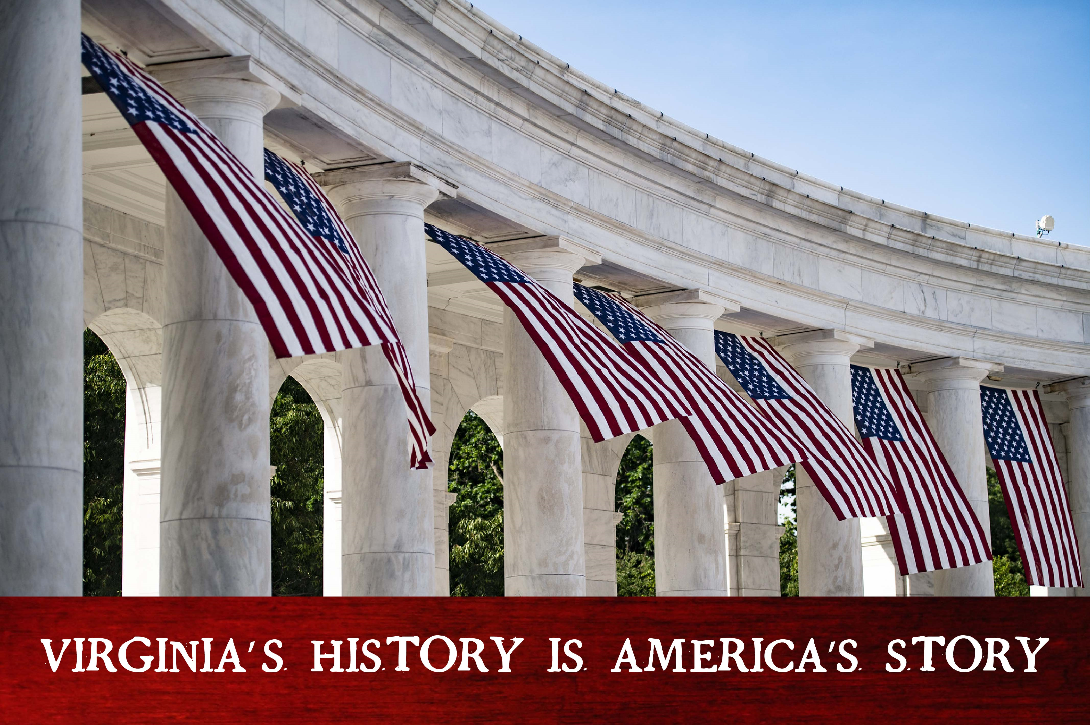
Follow VA250
Join us at VA250.org
#va250
@varevolution250
Notes:
Once in a generation opportunity . . . OUR CHANCE TO ENSURE that (click)
Every Student has access to opportunities to learn; inspire a life-long passion for learning
Every Teacher has access to resources in the classroom and professional development opportunities
Every community has access to programs, exhibits, events, and funding opportunities
Every Virginian sees themselves and their story in the commemoration
Virginia will shine in the 250th – and we can’t do it without you!

Slide 27
VA250.org

