Slide 1
Opportunities of the Semiquincentennial A Common Cause to All Williamsburg, Virginia March 10, 2023
John Dichtl President & CEO, American Association for State and Local History

Slide 2
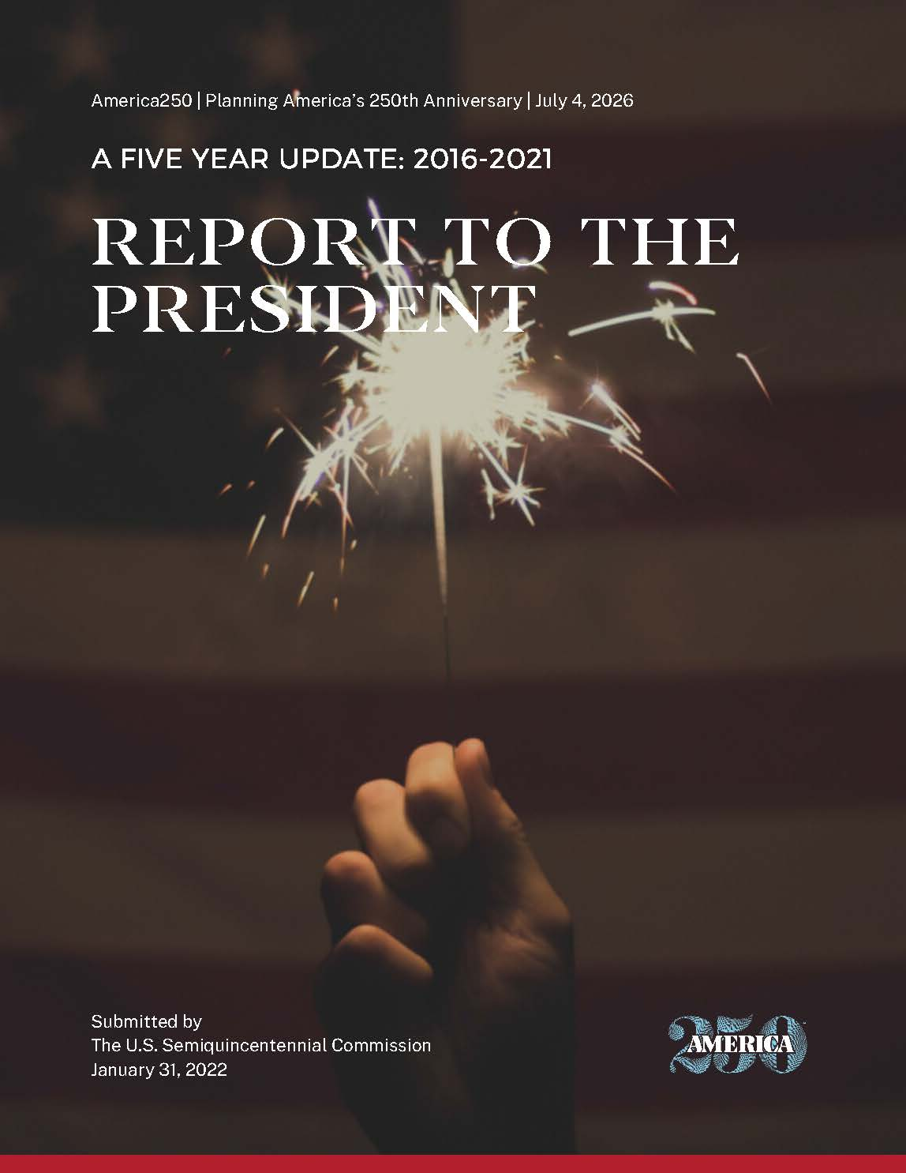
Federal-Level Planning
America 250 Foundation is the nonprofit administrative arm of the
U.S. Semiquincentennial Commission

Slide 3
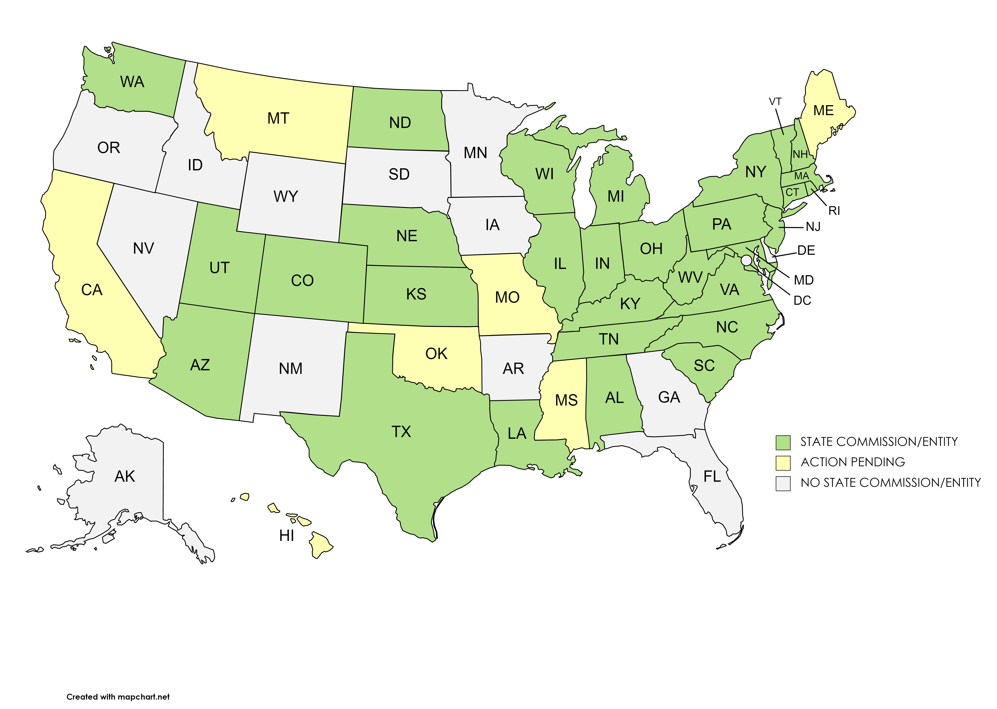
State-Level Planning

Slide 4
Vision for the 250th
…to help American society
progress towards justice through an inclusive approach to history and to
strengthen the history field by attracting interest and investment.

Slide 5
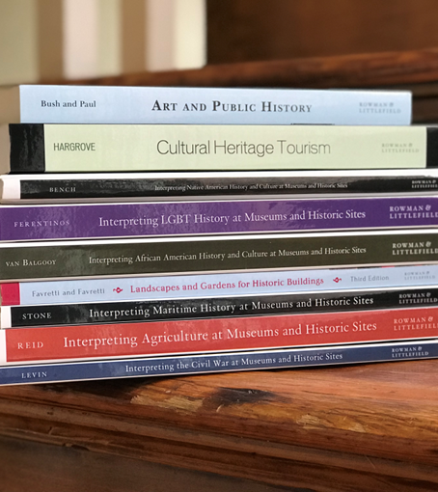
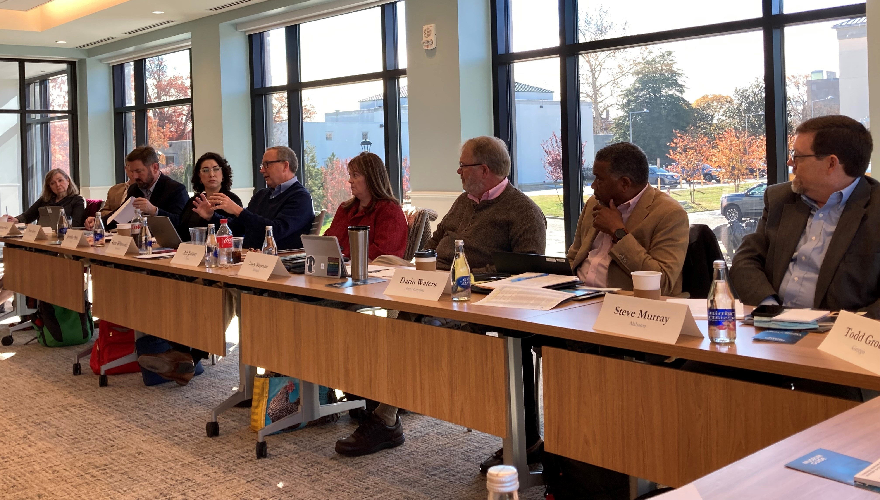
Background on AASLH

Slide 6
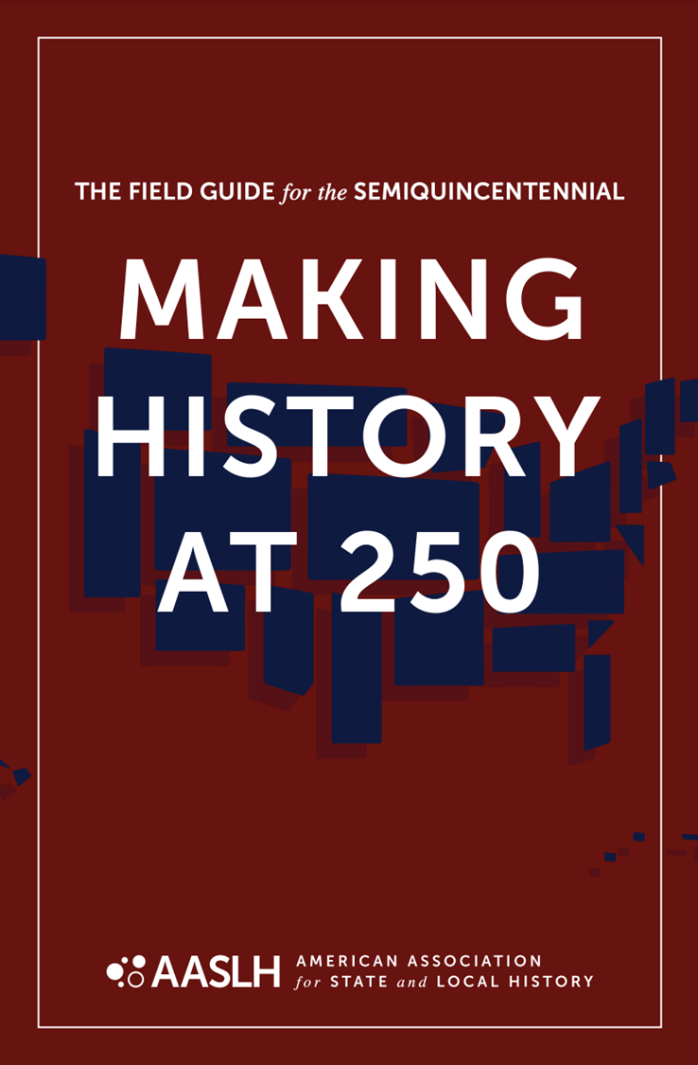
Field Guide Themes
1. Unfinished Revolutions
2. Power of Place
3. We the People
4. The American Experiment
5. Doing History

Slide 7
Long history to… and after Independence
Field Guide Themes
1. Unfinished Revolutions
2. Power of Place
3. We the People
4. The American Experiment
5. Doing History
Advancements and setbacks since 1776
Other revolutionary moments
Advancements and setbacks
Liberty and equality in your community

Slide 8
Connection to land
Field Guide Themes
1. Unfinished Revolutions
2. Power of Place
3. We the People
4. The American Experiment
5. Doing History
Who came before
Access to resources, waterways, food
Empire and colonization
Changes in your community
Preservation of landscapes and buildings

Slide 9
Who were considered “the people”?
Field Guide Themes
1. Unfinished Revolutions
2. Power of Place
3. We the People
4. The American Experiment
5. Doing History
Exclusion and inclusion of groups
Expansion of citizenship
What is an “American”?

Slide 10
Founders did not have all the answers
Field Guide Themes
1. Unfinished Revolutions
2. Power of Place
3. We the People
4. The American Experiment
5. Doing History
Toward a more perfect union
Civic action
Engagement in the present

Slide 11
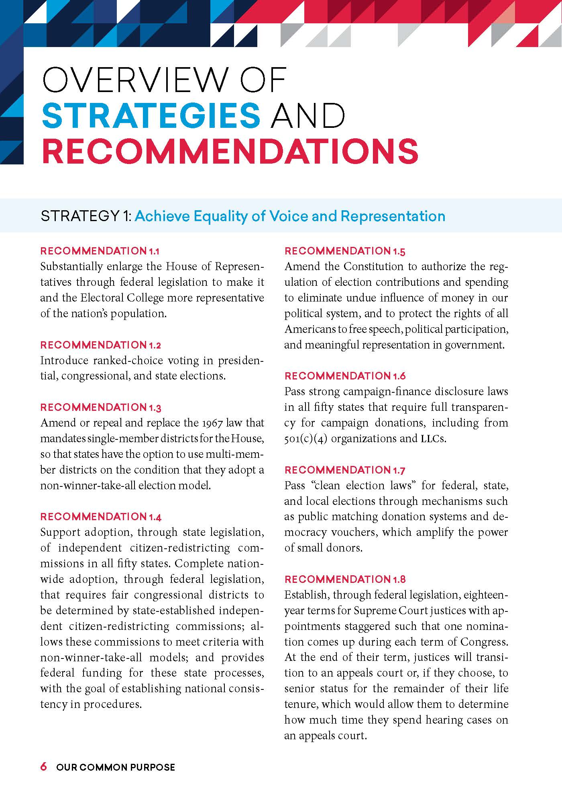
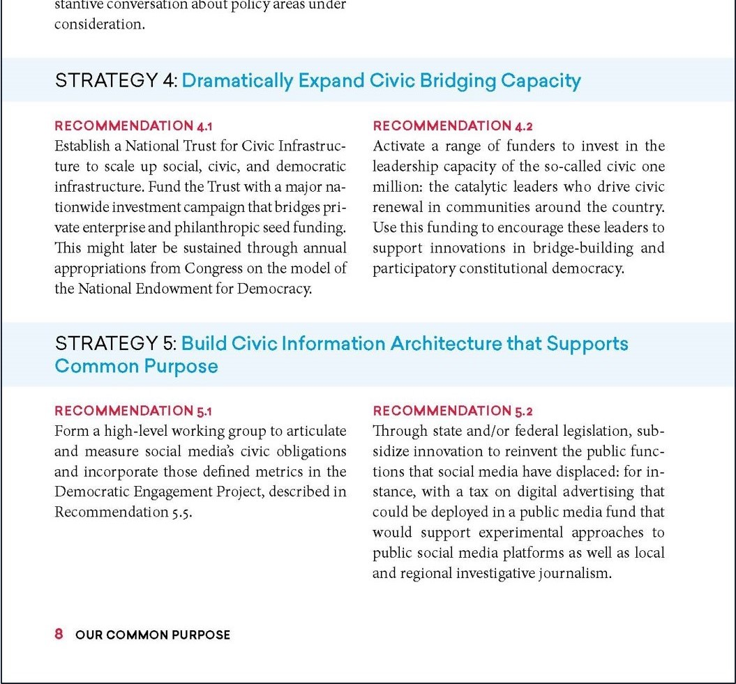

Slide 12
Invite public into the process of doing history
Field Guide Themes
1. Unfinished Revolutions
2. Power of Place
3. We the People
4. The American Experiment
5. Doing History
Transparency, uncertainty
What counts as evidence
Using different kinds of sources
Multiple perspectives

Slide 13
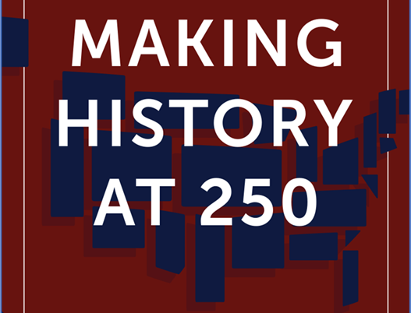
Institutional & Social Transformation | Our Changing Landscapes | We the People | Civic Participation A New Government & Constitution Contemporary Debates & Possibilities |  | A People in the World
Unfinished Revolutions | Power of Place | We the People | The American Experiment | Doing History

Slide 14
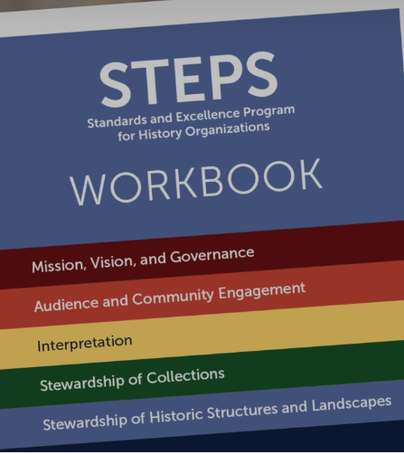
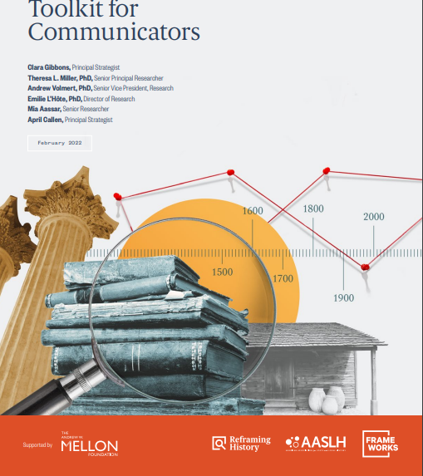
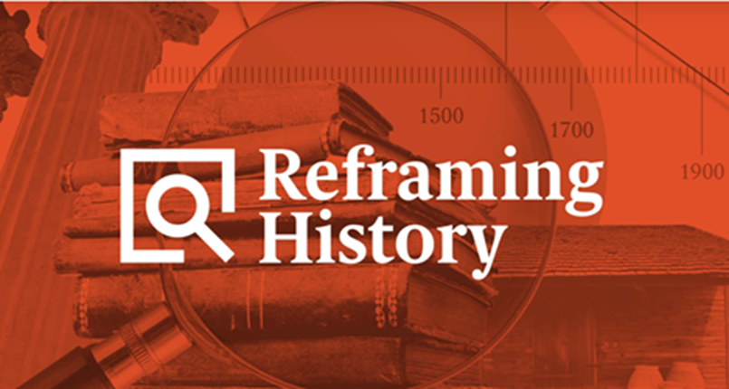
Other AASLH Resources

Slide 15
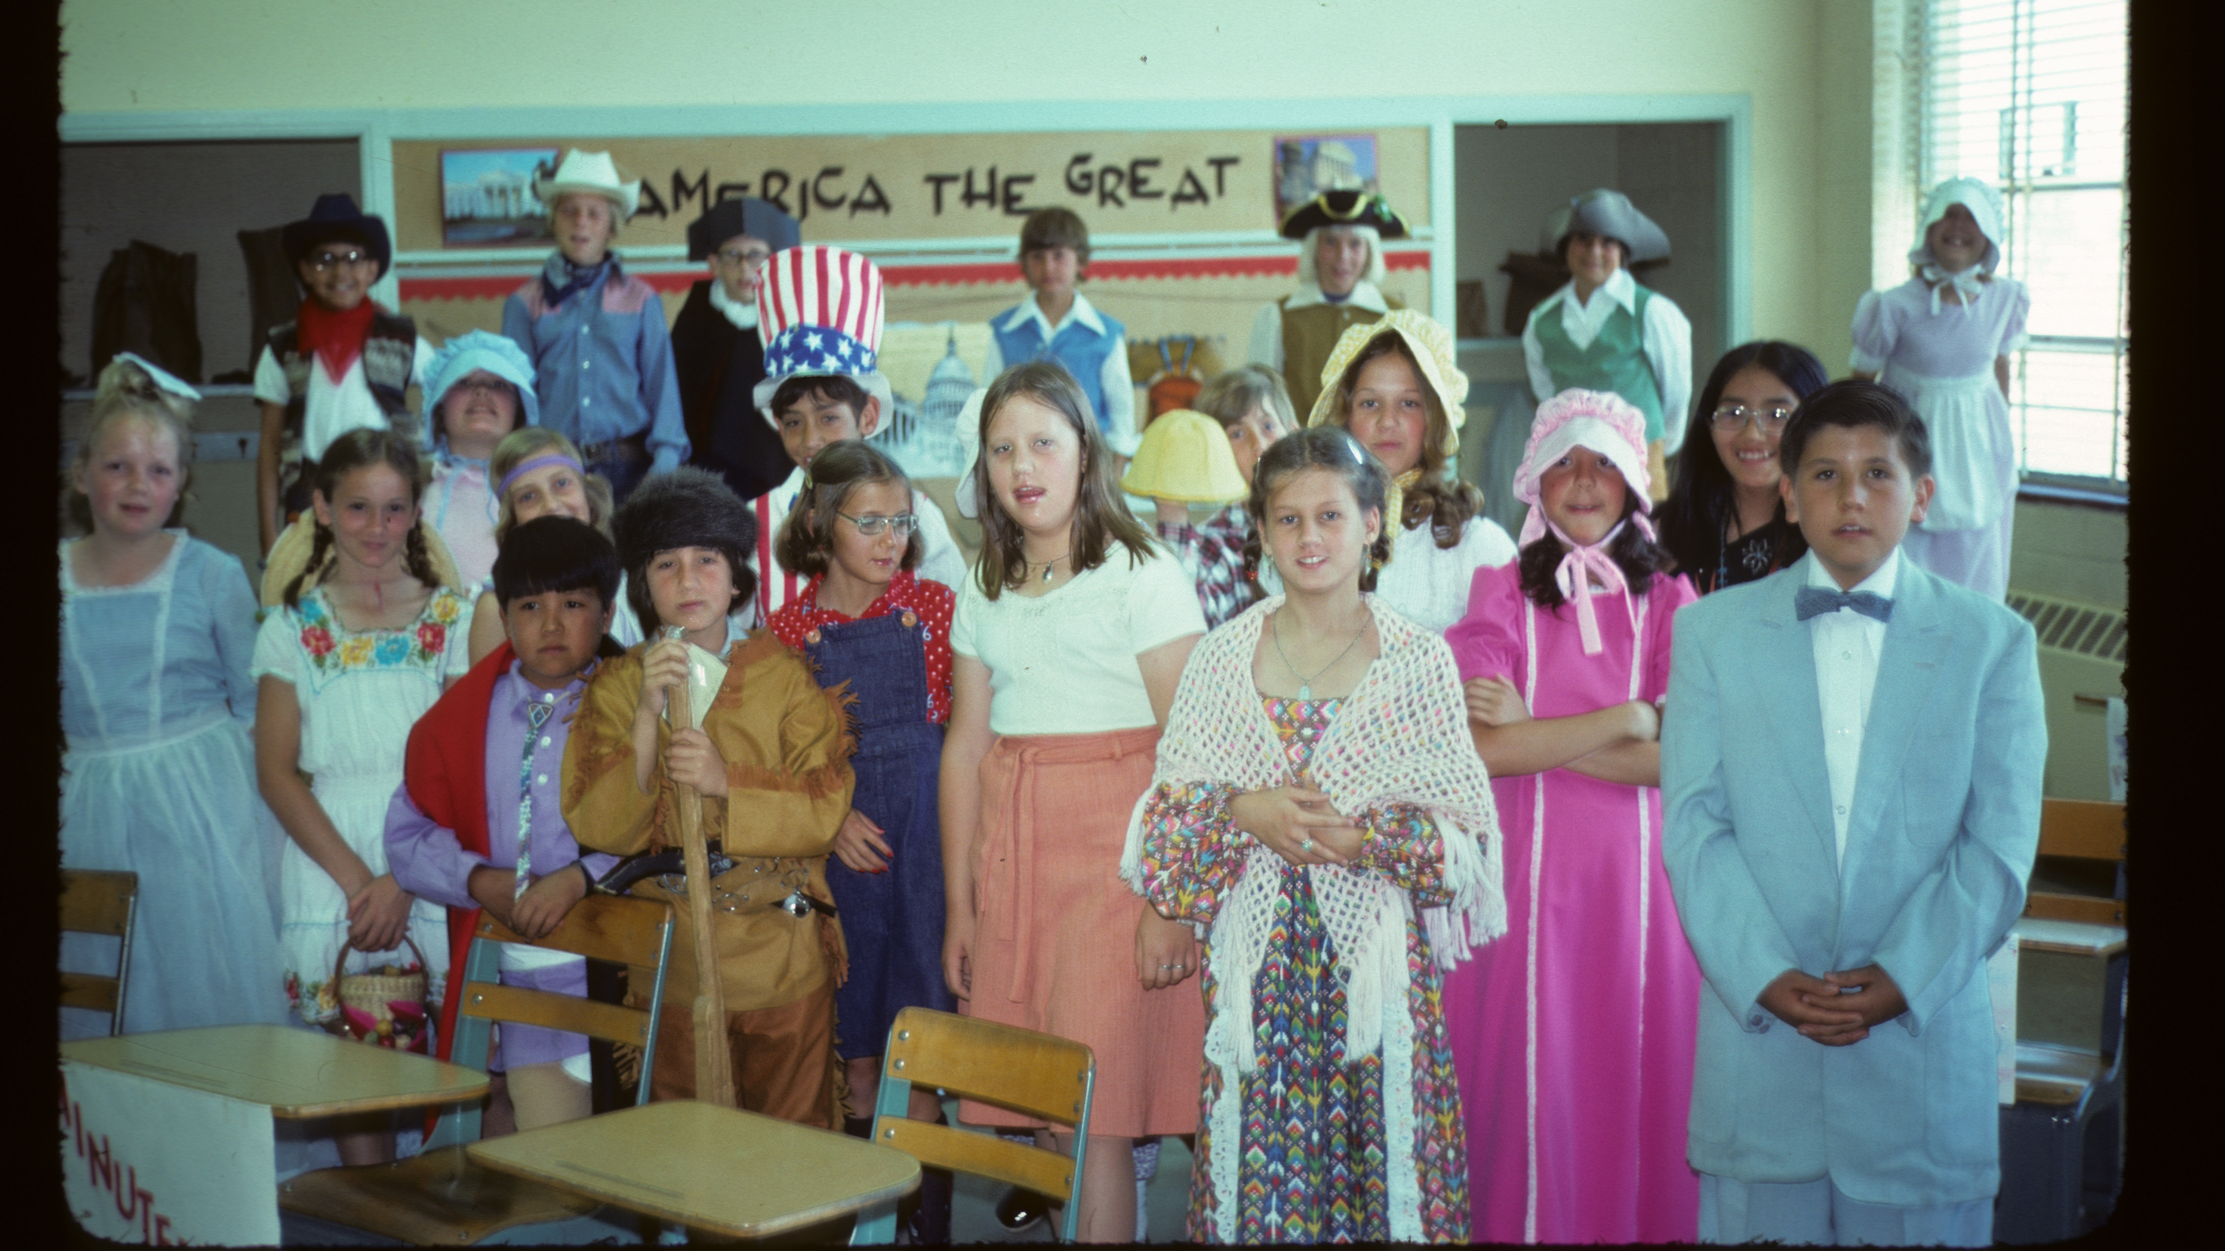
Albuquerque, New Mexico, 1976

Slide 16
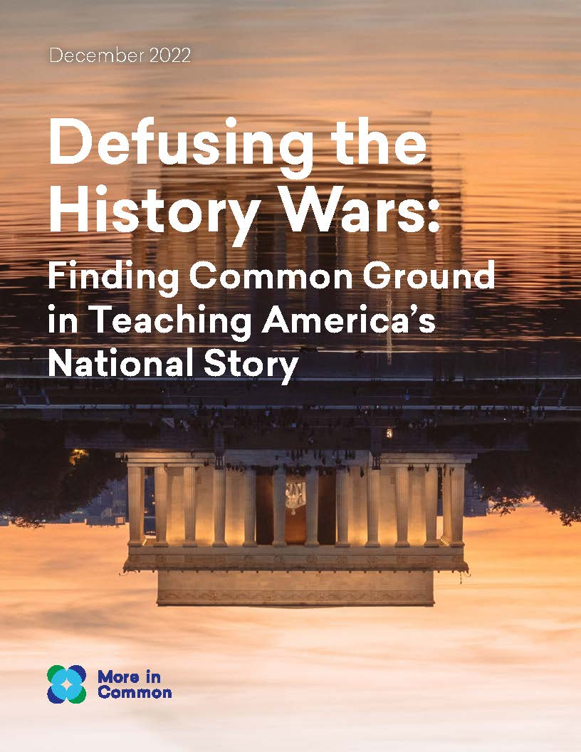

Slide 18
THANK YOU! A Common Cause to All Williamsburg, Virginia March 10, 2023
John Dichtl President & CEO, American Association for State and Local History
dichtl@aaslh.org

