Slide 1
VA250.org

Slide 2
VA250 Commission
About VA250
Strong state support
Robust local committees
Committed corporate partners
Key national leadership role

Slide 3
VA250 Commission
About VA250
Guiding Principles
Strong state support
Robust local committees
Committed corporate partners
Key national leadership role
Statewide commemoration
Multi-faceted
Inclusive of all perspectives
Every Virginian can see their story

Slide 4
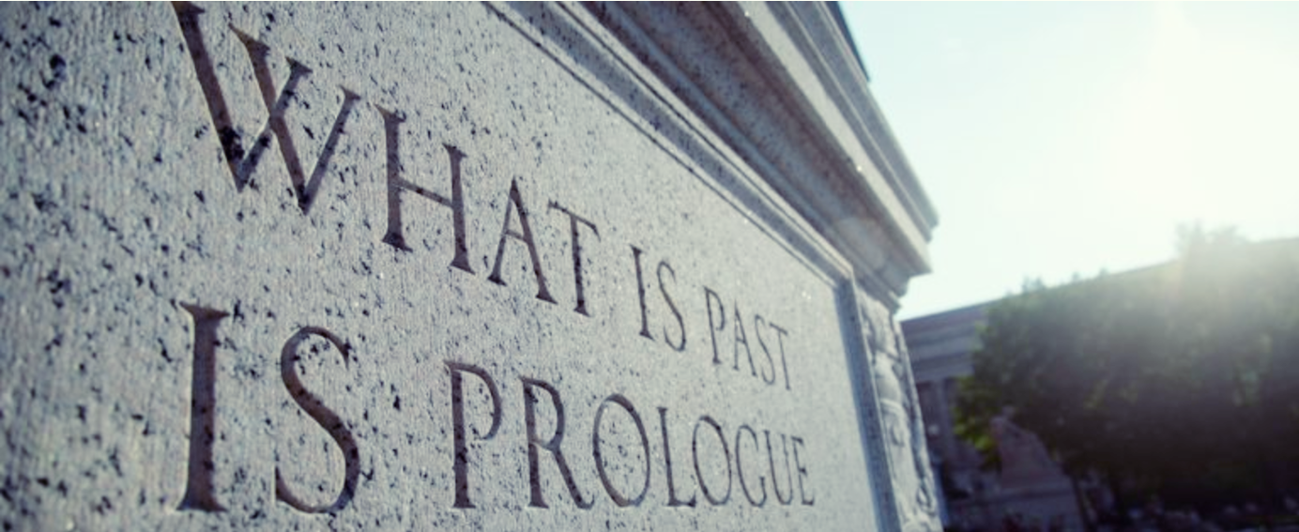
Economic Impact of Commemorations
$1.5 Billion economic impact to Virginia
22,000 Jobs created across the Commonwealth
$50 Million in state and local tax revenue
9 Million people participating in events and programs
Extensive media impressions, interviews, articles, social media interaction

Slide 5
Plans in Development

Slide 6
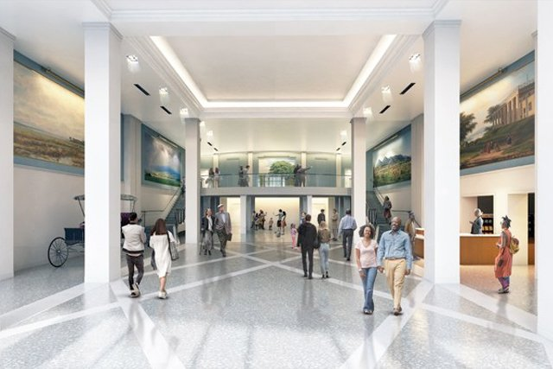
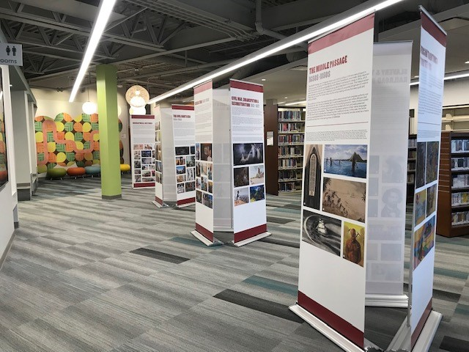
Signature Exhibition with Traveling Panels
Plans in Development
Partnership between Virginia Museum of History and Culture and Jamestown Yorktown Foundation
(Part I) 5,000 sq. ft. cutting-edge museum exhibition with online component for schools
(Part II) Traveling Panel Exhibition
Provided to localities, at no cost, for display in small museums, libraries, community centers
Notes:
Shared installation
VMHC: March 2025 – January 2026
American Revolution Museum at Yorktown: April 2026 – January 2027
Exhibition may then travel to other museums across Virginia

Slide 7
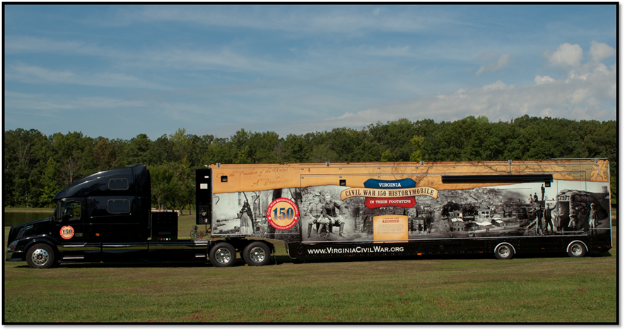
Mobile Museum Mobile Museum
Plans in Development
Notes:
Immersive, interactive exhibit
Will travel to every locality . . . . And beyond!
National centerpiece
Events in Boston, Philadelphia – we can be right there!

Slide 8
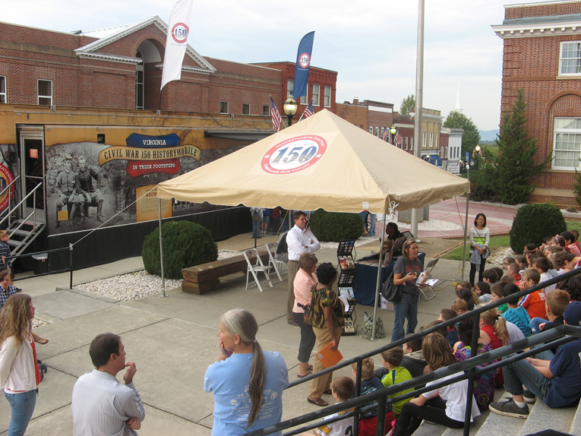
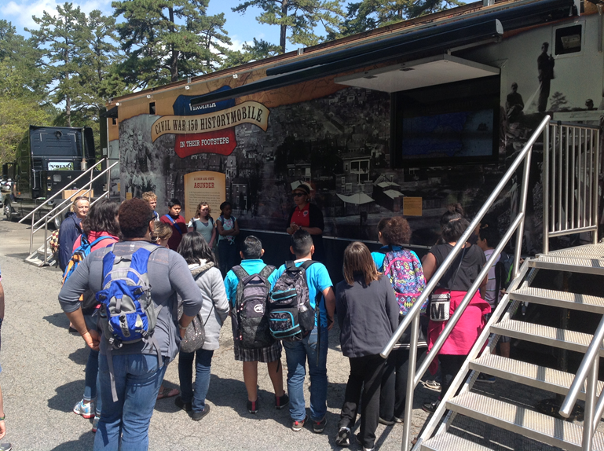
Mobile Museum: Schools
Notes:
Museum travels directly to schools
Hard for many localities to afford field trips – Classroom for the day
Teacher Resources and pre-visit/post-visit classroom materials

Slide 9
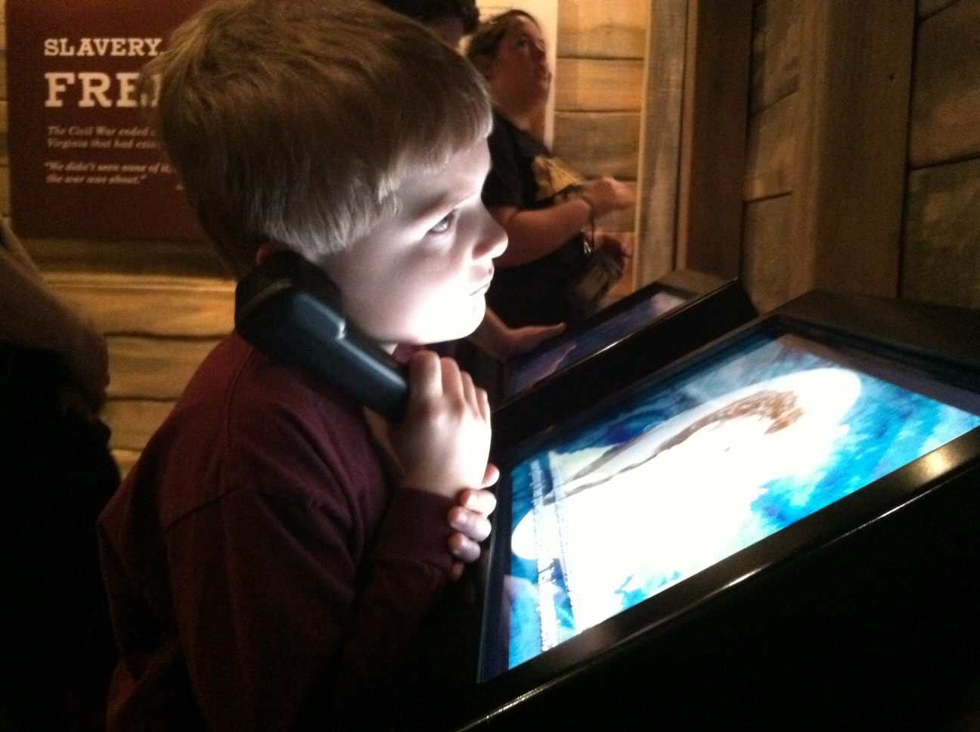
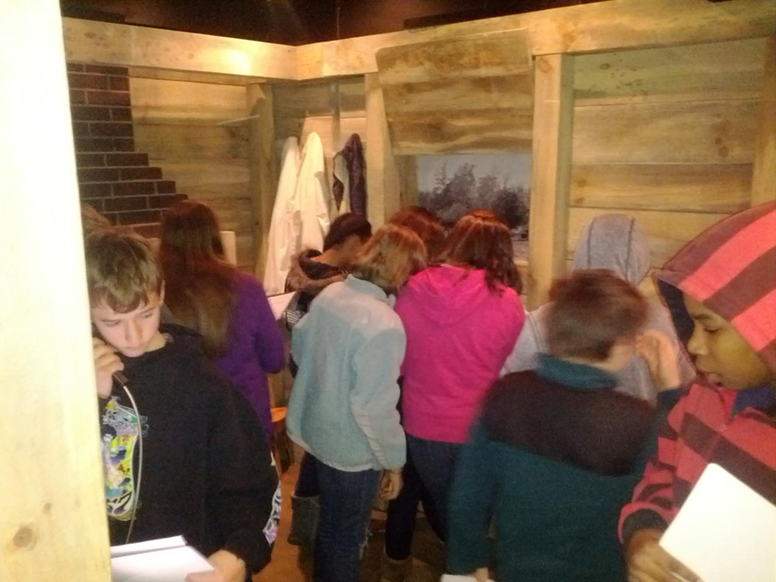
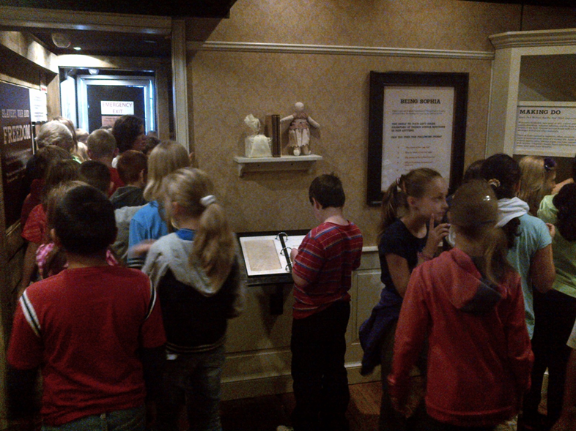
Mobile Museum: Schools
Notes:
Hands-on learning
Interactive
Captures students’ imagination

Slide 10
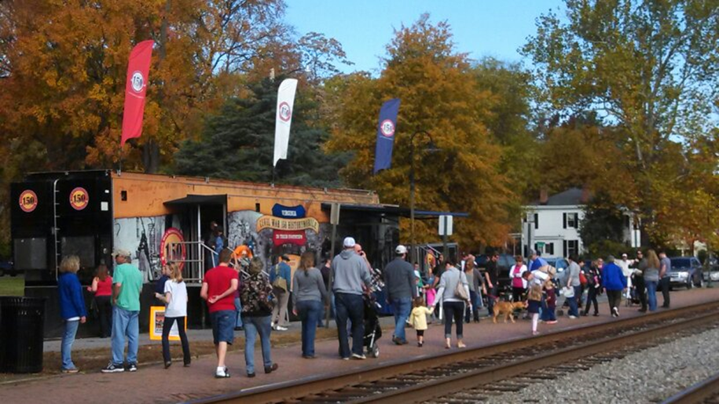
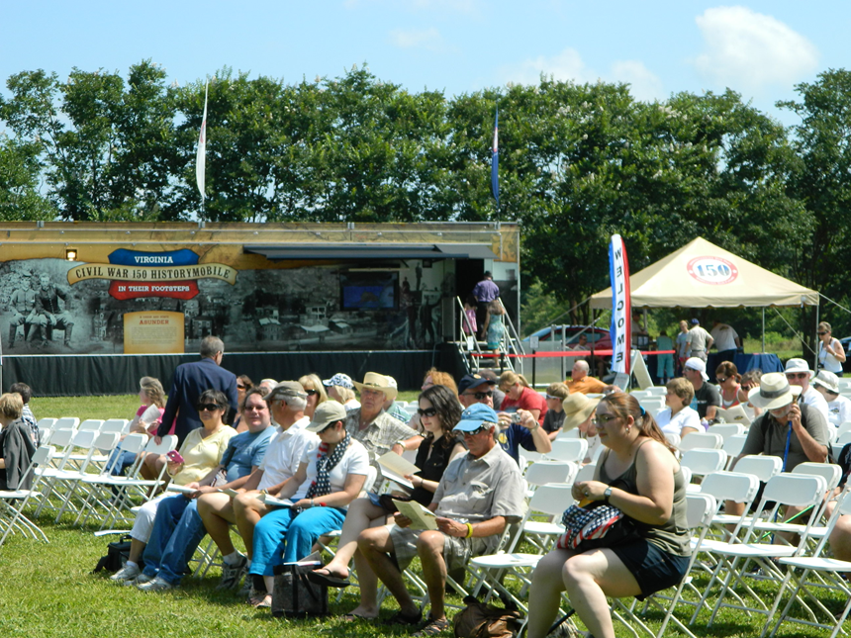
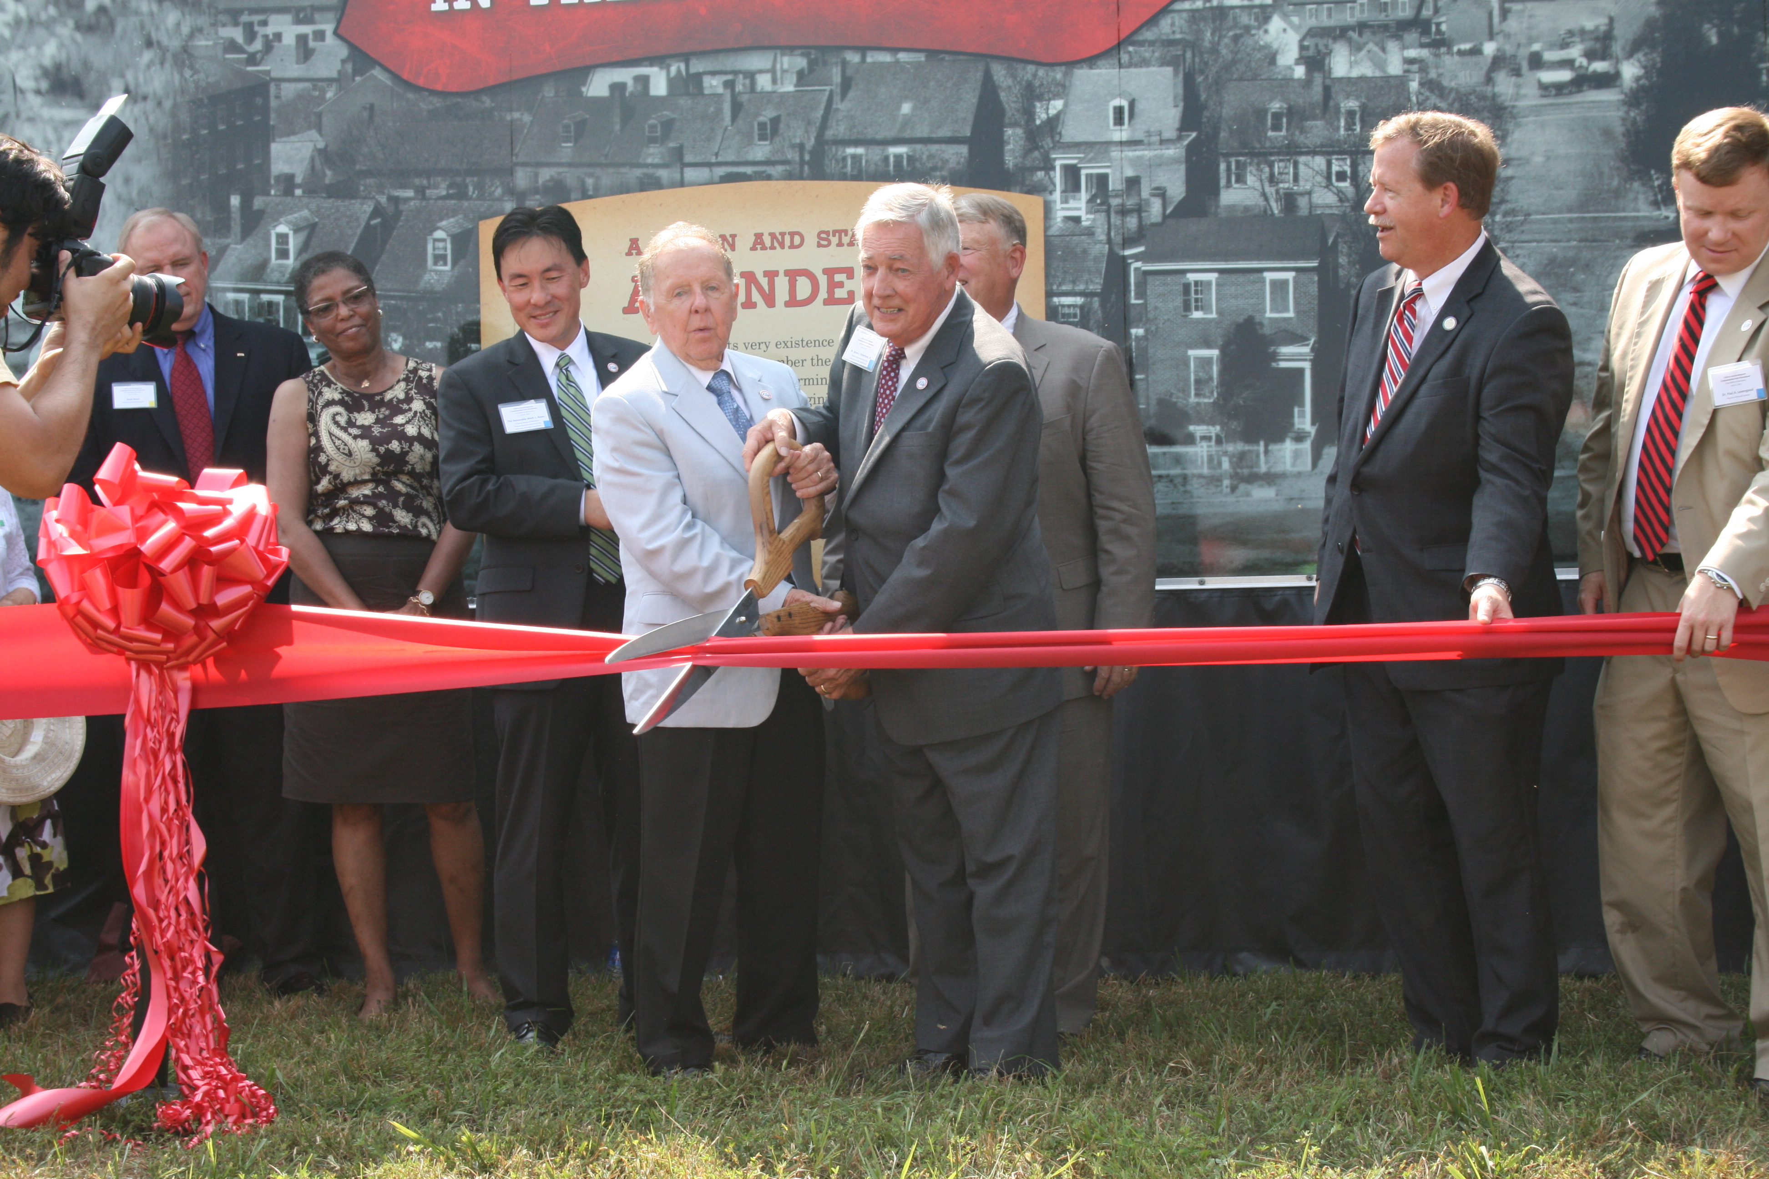
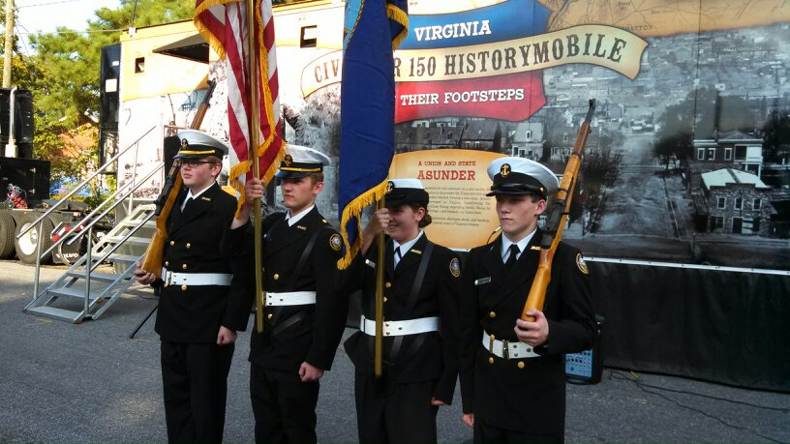
Mobile Museum: Centerpiece of Events
Notes:
Centerpiece of planned events (Ashland Train Day, State/county fairs)
And sometimes. . .
It *is* the event – localities plan a weekend of events around the Mobile Musuem visit – add lectures, bands, document scanning, veteran recognition

Slide 11
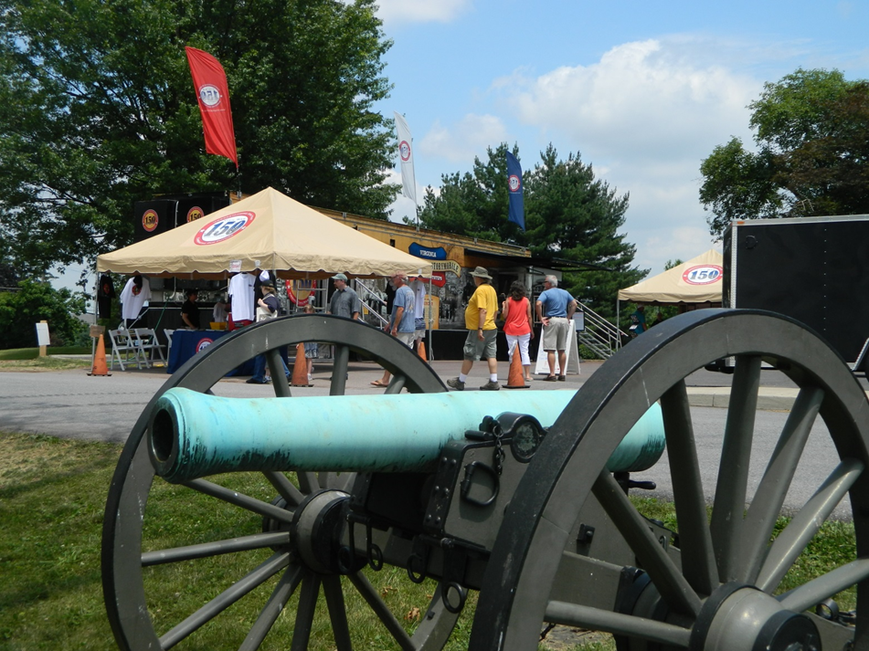
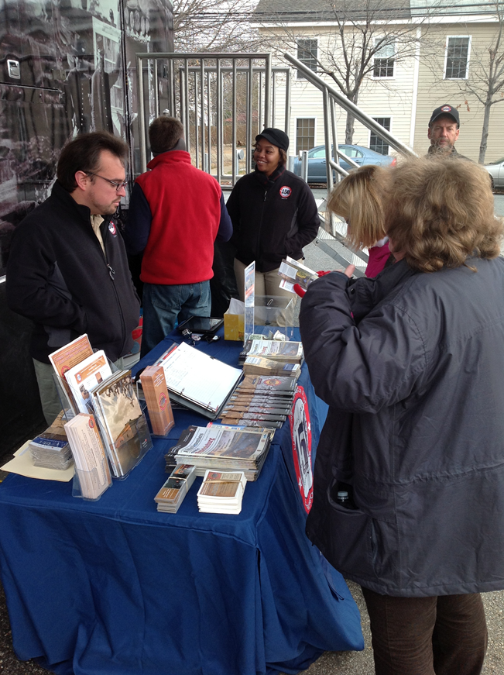
Marketing and Partner Messaging
Notes:
Virginia Welcome Center on Wheels
Operate in partnership with VTC
Marketing tents and displays are set up at every event
Partner / donor messaging has wide reach

Slide 12
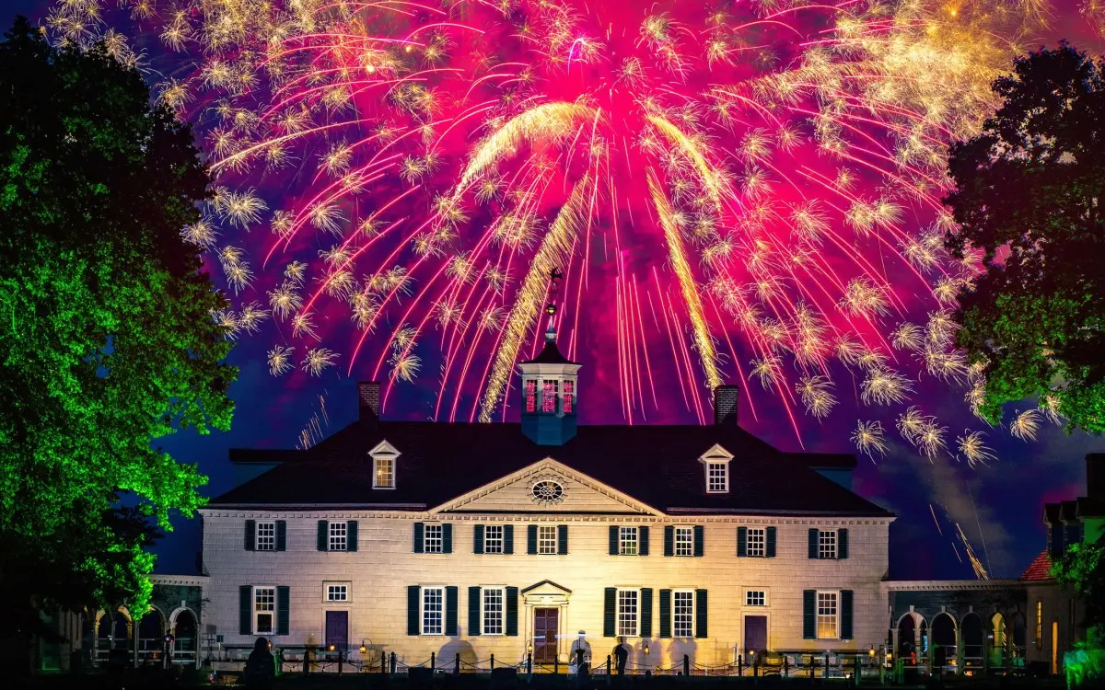
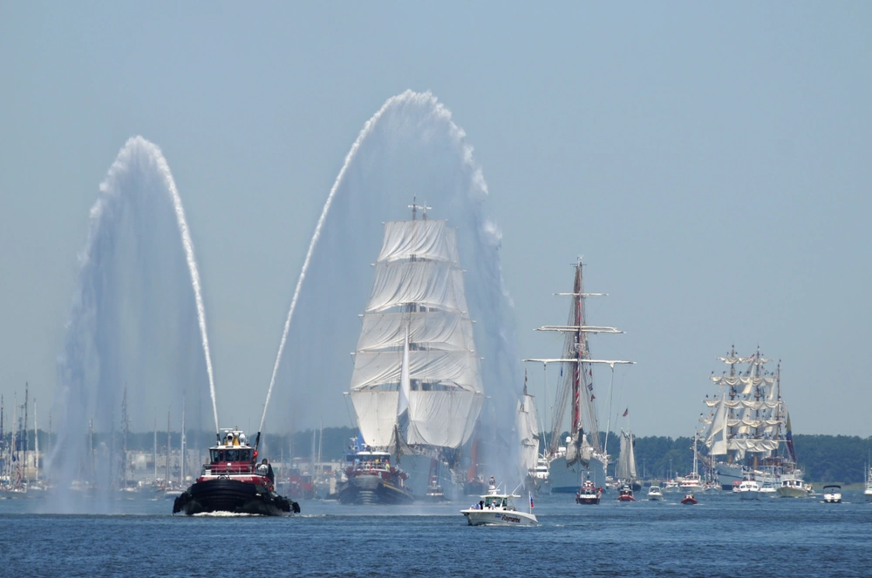
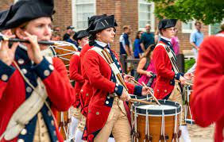
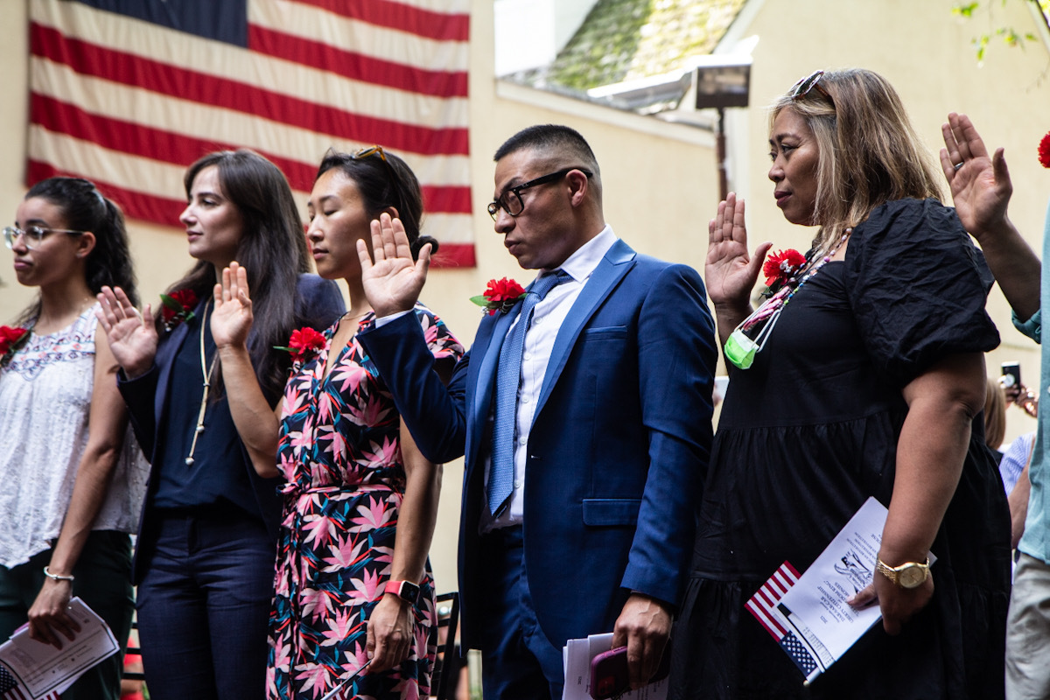
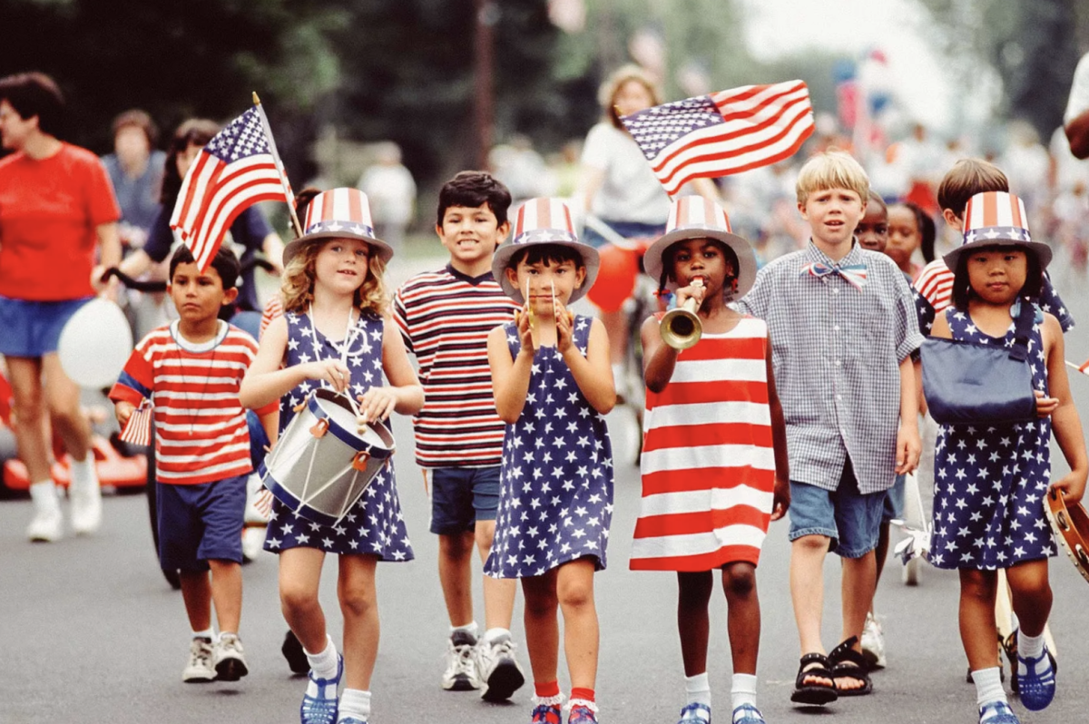
2026
Signature Events and Conferences
1776
Notes:
Everyone thinks of the 250th as happening in 2026, marking the signing of the Declaration of Independence in 1776
And that’s true. . . .
Special events and conferences will be happen throughout the nation in 2026 and Virginia will lead the way:
Sail 250: National six-port tall ship sail docking in Norfolk and Alexandria
250th Fifth Virginia Convention: Virginia’s Independence Day (May 15)
250th Declaration of Independence (July 4)
Large-scale Naturalization Ceremony
Statewide tolling of bells
Events to honor military and veterans
Massive fireworks show at key locations
But it’s not the whole story. . . .

Slide 13
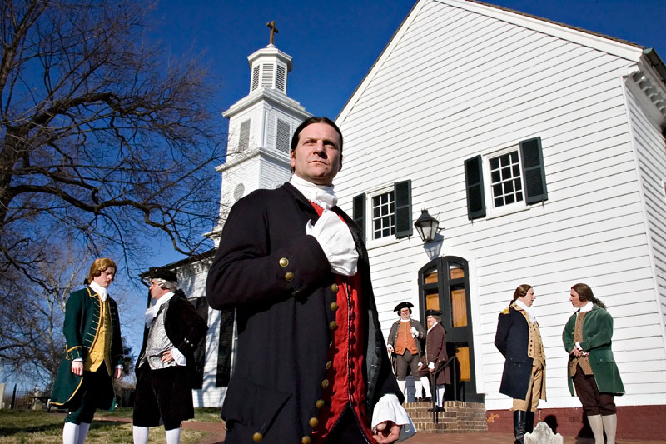
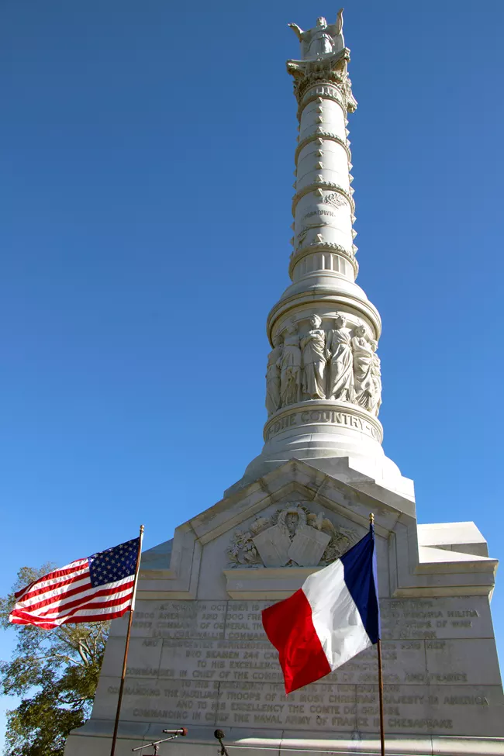
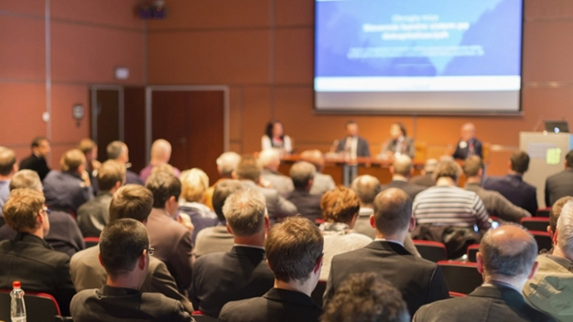
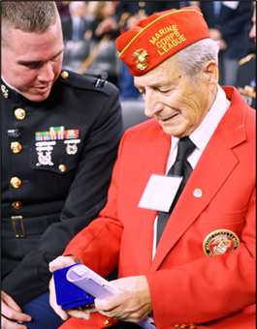
Signature Events and Conferences: 2023- 2031
Notes:
HOWEVER, in Virginia, the 250th begins NOW and go through 2031, marking events of
1773 – 1781 (see folder for details), including:
2023: A Common Cause to All – 250th Anniversary of Committees of Correspondence
2024: Lafayette’s Grand Tour 200th – 26-state Guest of the Nation Tour
250th Yorktown Tea Party (Nov. 9, 2024)
2025: Law Symposium “The Legal Revolution: Virginia Leads the Way to Liberty”
250th Patrick Henry’s “Give Me Liberty or Give Me Death”
2026: Virginia takes key role on national stage
2031: Siege of Yorktown and British Surrender at Yorktown

Slide 14
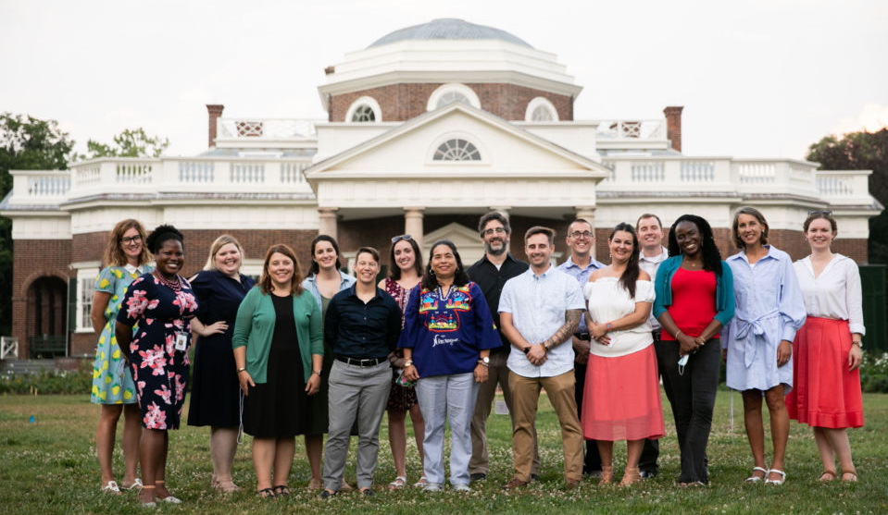
K-12 and Higher Education Partnerships
Educational Opportunities
Multi-partner Teacher Institutes held statewide
Classroom resources and curriculum development for teachers
Online content aggregator as one-stop resource
Lesson plans, essay contests
Podcasts, blogs, videos
Notes:
Teacher Training institutes with history museum partners across the state
Classroom resources
Goal: Ignite a life-long love of learning in students– much as the Bicentennial did for many of us assembled here –
….and ensure that teachers have the tools and resources available to foster that curiosity

Slide 15
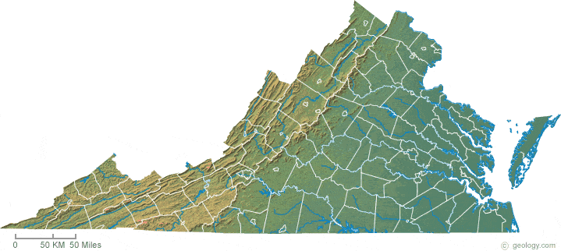
Grants to support local events throughout Virginia
Local Community Grants
VA250 grant program to provide funding to local communities and partner organizations
Virginia Tourism VA250 Marketing Leverage Grants
Virginia Humanities VA250 Content Development Grants
Signature Partner Program/Event Grants

Slide 16
Impact of VA250
Every student
Every teacher
Every community
Every Virginian
VA250 – Please join us!
Notes:
Once in a generation opportunity . . . OUR CHANCE TO ENSURE that (click)
Every Student has access to opportunities to learn; inspire a life-long passion for learning
Every Teacher has access to resources in the classroom and professional development opportunities
Every community has access to programs, exhibits, events, and funding opportunities
Every Virginian sees themselves and their story in the commemoration
Virginia will shine in the 250th – we hope you’ll join us!

Slide 17
VA250.org

